Slide 1
Implementation for Green Water Management Project in the dryland areas of Myanmar
TA-REG 8163
Implementation of Core Agriculture Support Program
Phase II (CASP 2) Activities under LOA in Myanmar
Project Implementation Unit (PIU)
Land Use Division
Department of Agriculture (DOA)

Slide 2
Background
Vision of CASP 2 : For the GMS to be “recognized as the leading producer of safe food, using climate friendly agricultural practices and integrated into global markets through regional economic corridors”.
Myanmar’s geographical location, topography and climatic conditions provide a setting for different agro-ecological zones and make it feasible to grow tropical, sub-tropical and temperate crops.
Agricultural sector is one of the most sensitive sectors to climate variability and climate change.
The potential impacts of climate change on dryland agriculture are critical

Slide 3
Background
Dry Zone, one of the poverty-stricken areas in Myanmar (13% of land)
About 23% of the total population (majority) depend on agriculture and allied activities for their livelihoods.
Annual rainfall ranges from 700 mm to 1270 mm.
Rainfall distribution is uneven and unstable.
Local people rely on an unstable income from agriculture and limited opportunity for employment.

Slide 4
Objectives
To create green water management model in the dryland areas of Myanmar
To promote green water management awareness and best practices to local staffs and farmers through the efficient utilization of rainwater as supplementary water for the year round crops cultivation
To increase food security, food safety, households income and adaptive capacity of poor rural households to climate change and promote market linkages for smallholder farmers
To recommend policy makers for developing green water management in dryland areas of Myanmar

Slide 5
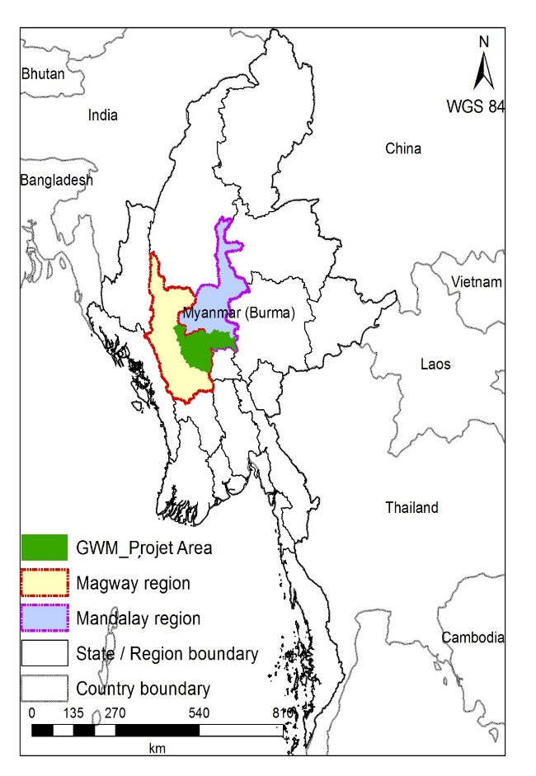
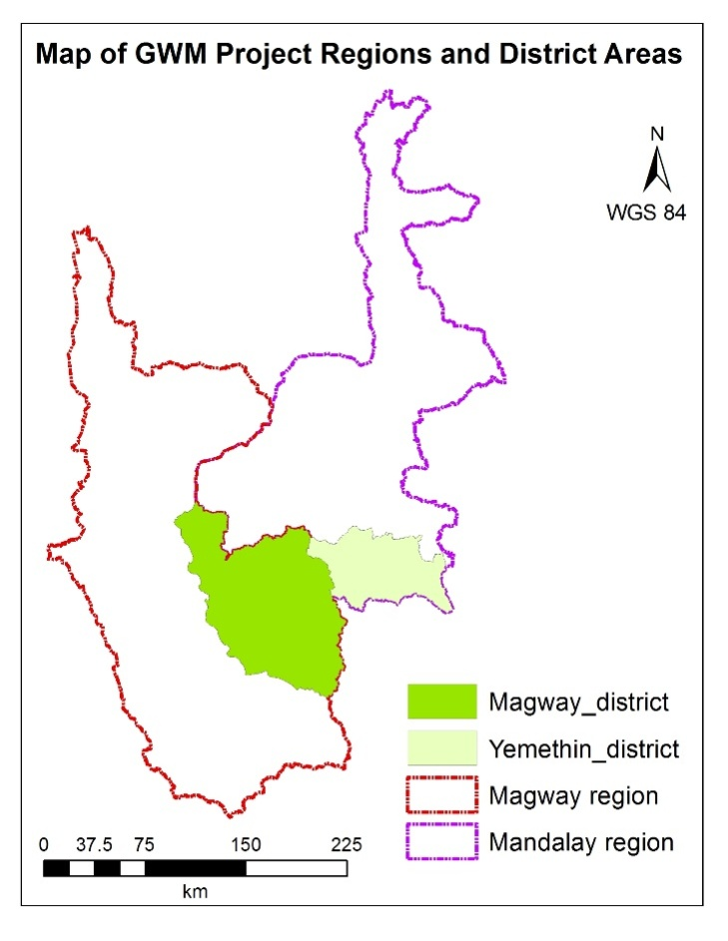
Map of Project Area

Slide 6
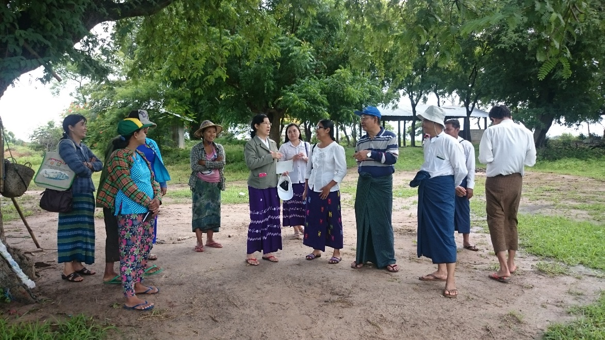
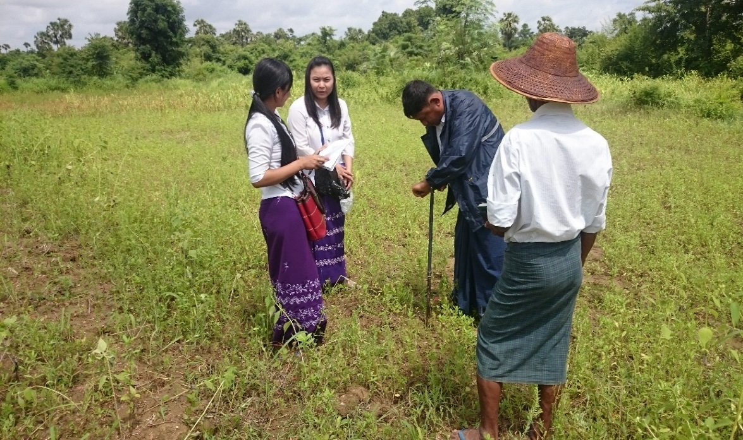
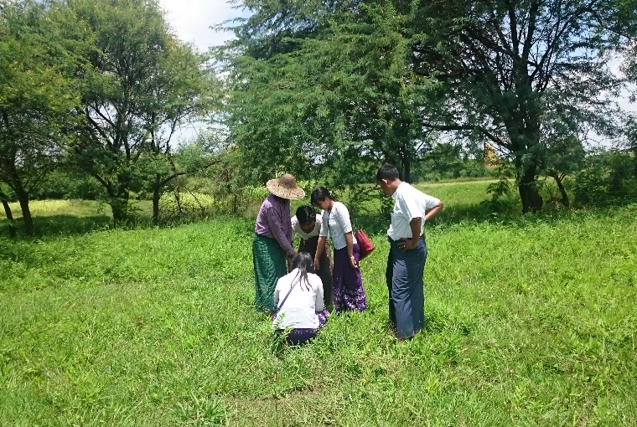
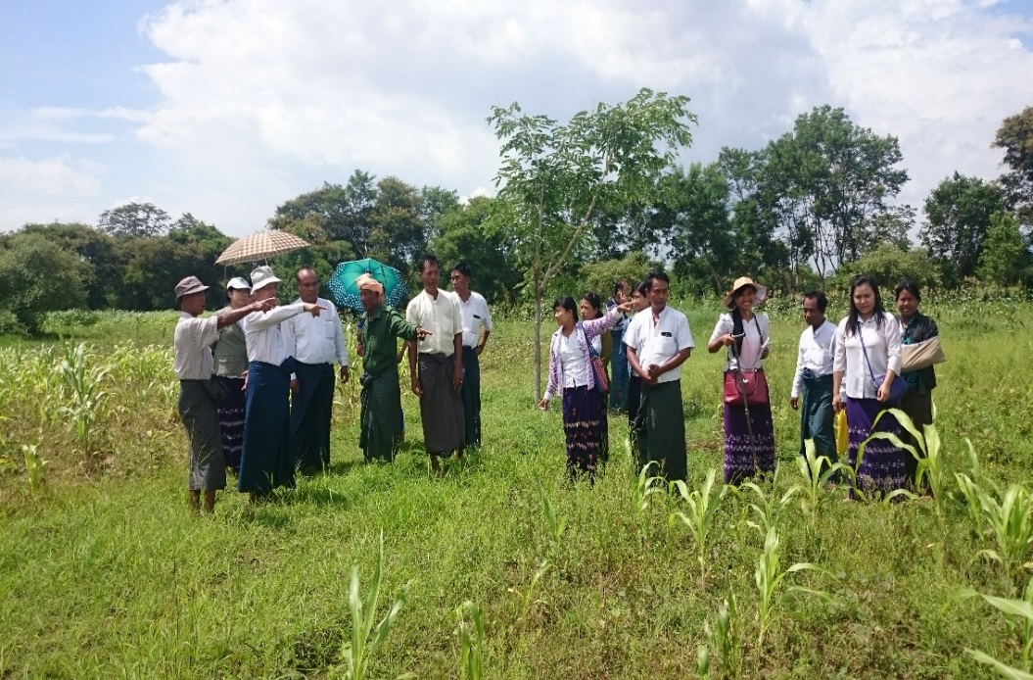
Field visit for Site Selection

Slide 7
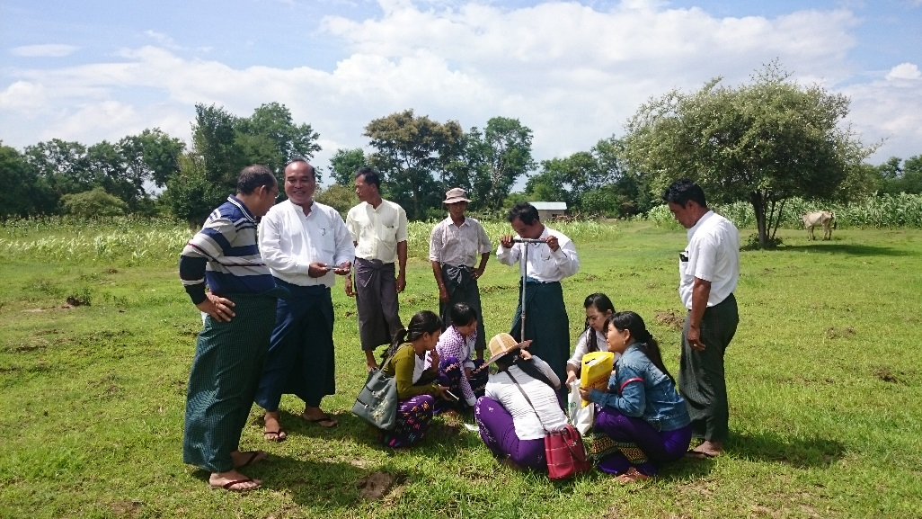
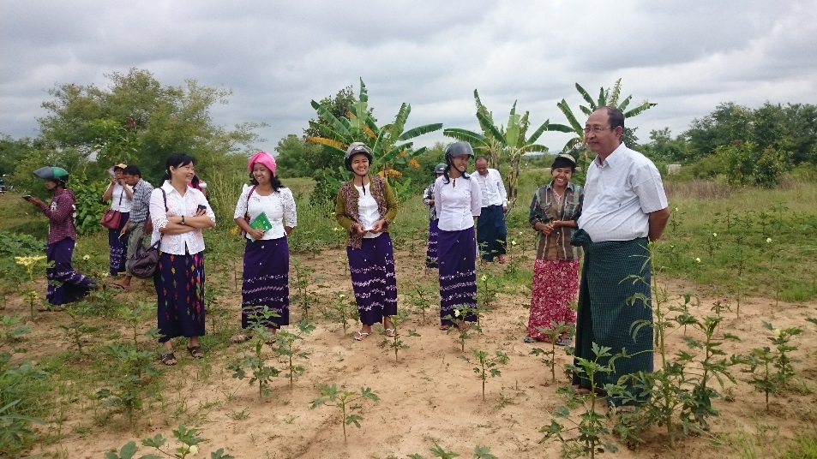
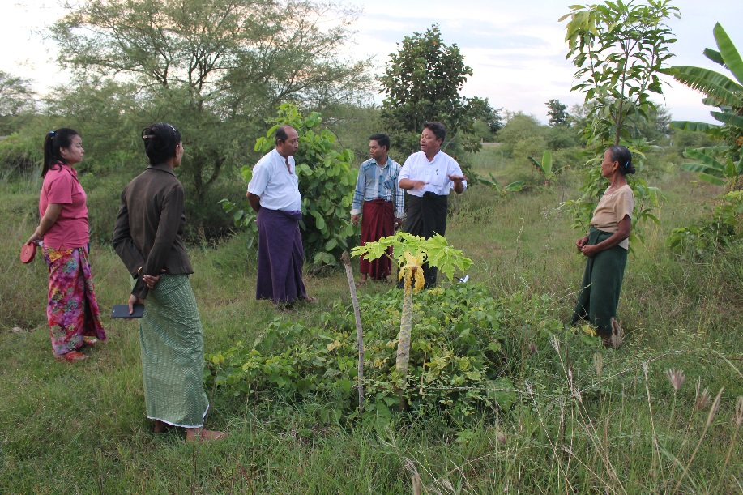
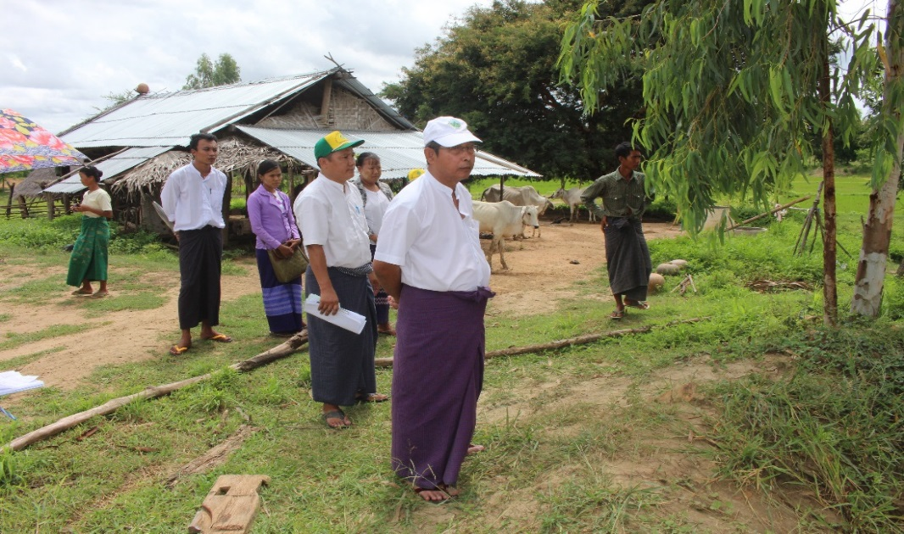
Field visit for Site Selection

Slide 8
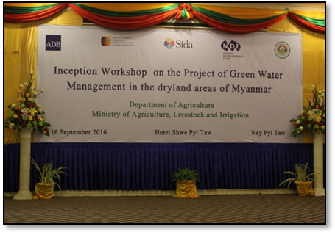
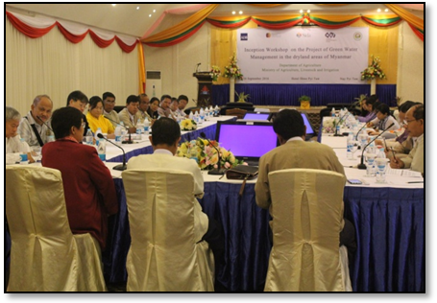
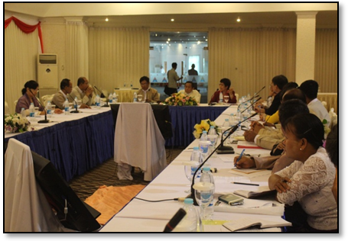
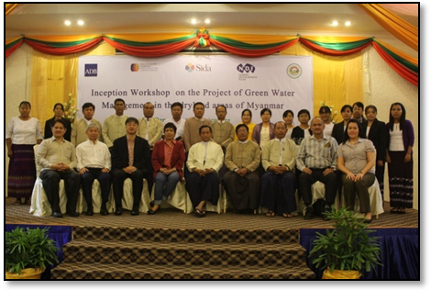
Inception Workshop on GWM Project : Hotel Shwe Pyi Taw, Nay Pyi Taw

Slide 9
Progress activities
6 demonstration sites
Capacity Building: 200 staffs
TOT training (50 officers for GWM and 34 officers for M&E )
Training for 300 farmers (at least 25% women) ( 9 times)
Supporting demo farm inputs included Biochar Kiln
6 pilot projects (already included about 22 pilot farmers)

Slide 10
List of farm demonstration sites
Establishment of demonstration farm for Green Water Management in
Theingone village, Yamethin Township, Mandalay Region
(Demo Farmer: U Min Thet)
II. Saegyi village, Yamethin Township, Mandalay Region
(Demo Farmer: U Maung Myint)
III. Satcho village, Pyawbwe Township, Mandalay Region
(Demo Farmer: Daw Tin Tin)
IV. Nakyarhtoo village, Natmauk Township, Magway Region
(Demo Farmer: U Kyaw Soe)
V. Shwekwe village, Natmauk Township, Magway Region
(Demo Farmer: U Thein Hlaing)
VI. Thanngone Village,Myothit Township, Magway Region
(Demo Farmer: Daw Myint 2 Mu)

Slide 11
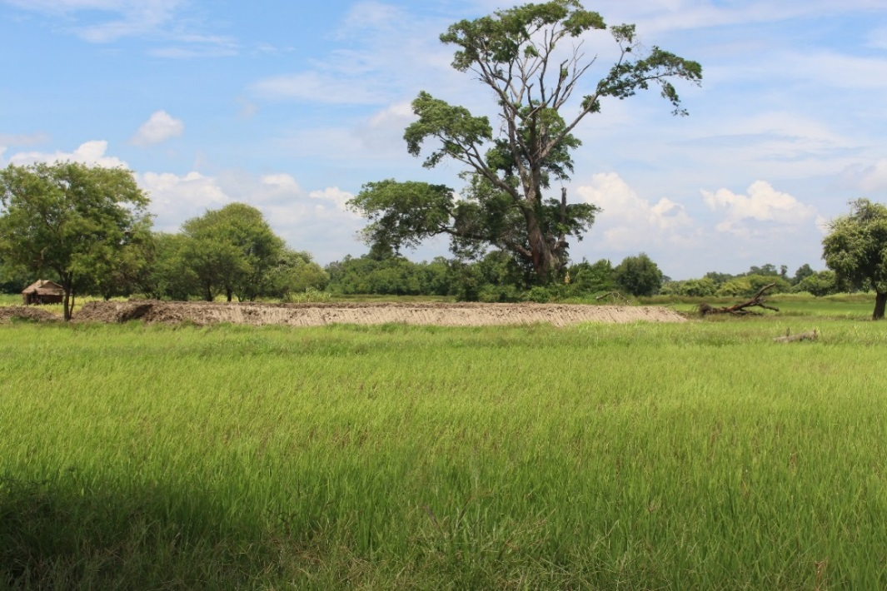
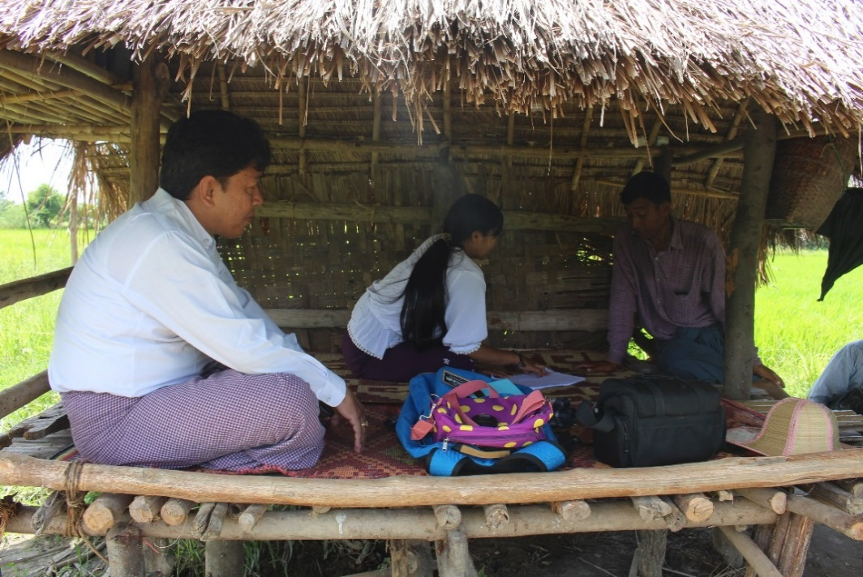
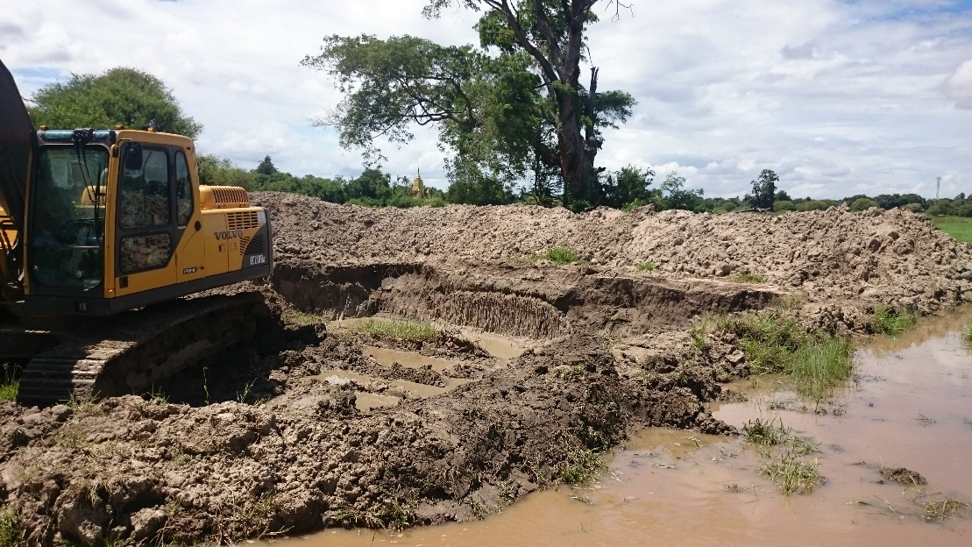
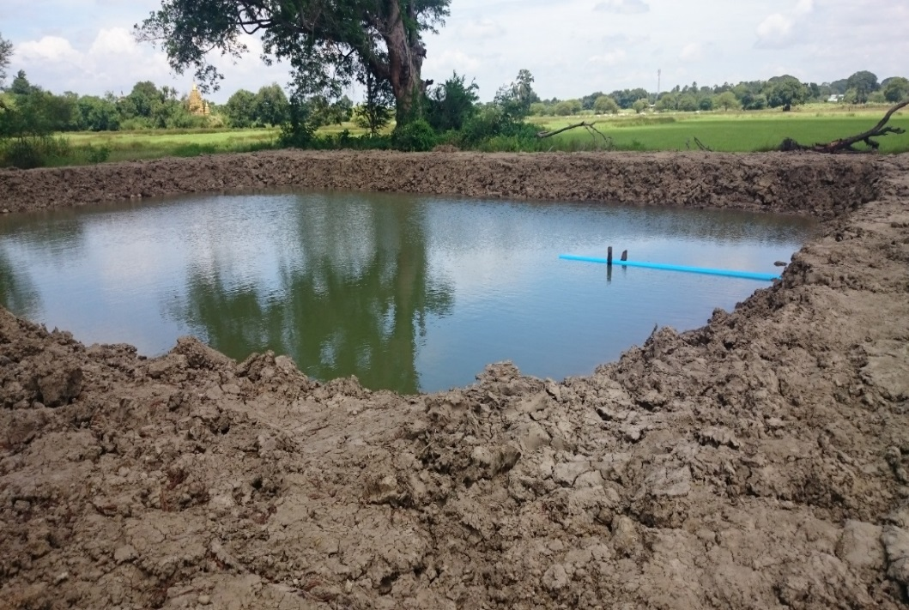
U Min Thet’s Farm, Theingone Village, Yamethin Township

Slide 12
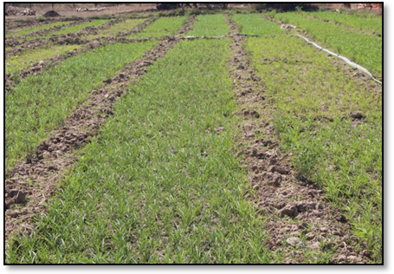
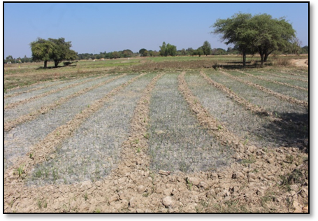
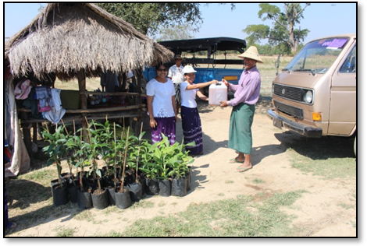
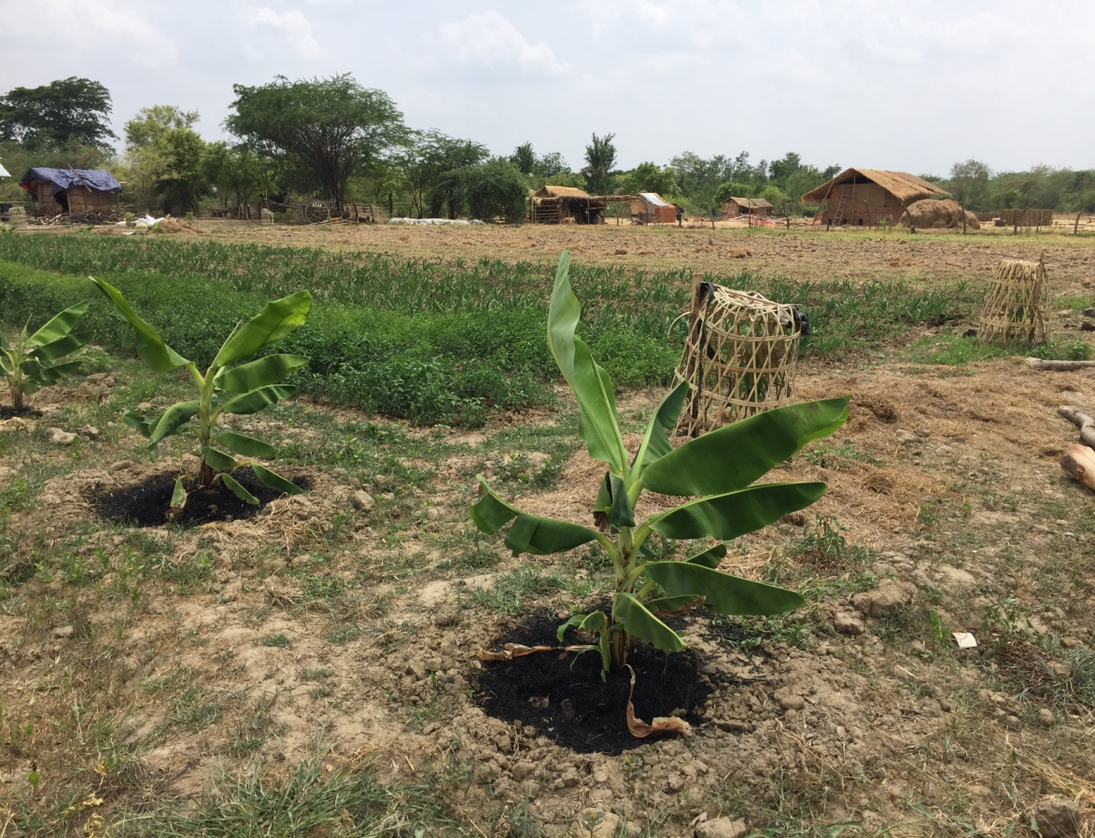
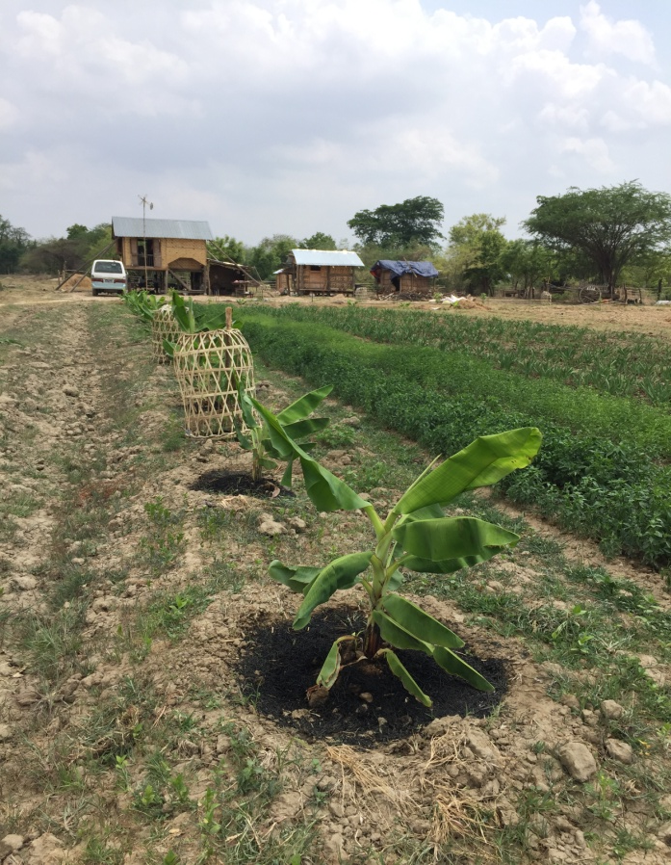
U Min Thet’s Farm, Theingone Village, Yamethin Township

Slide 13
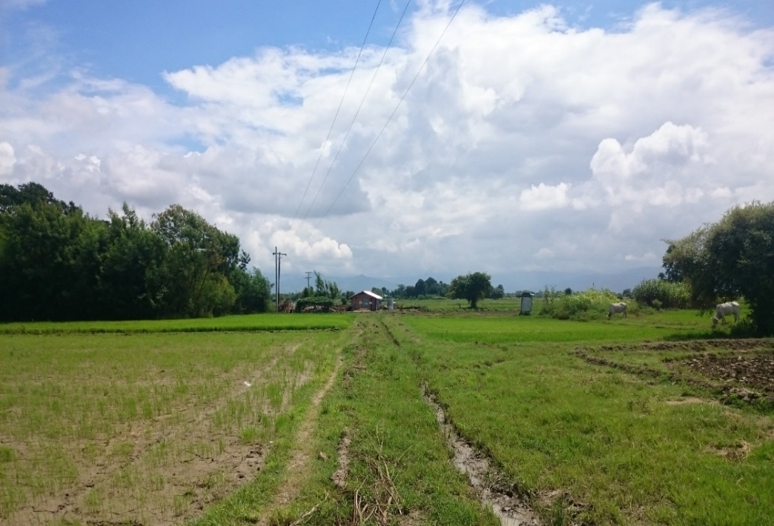
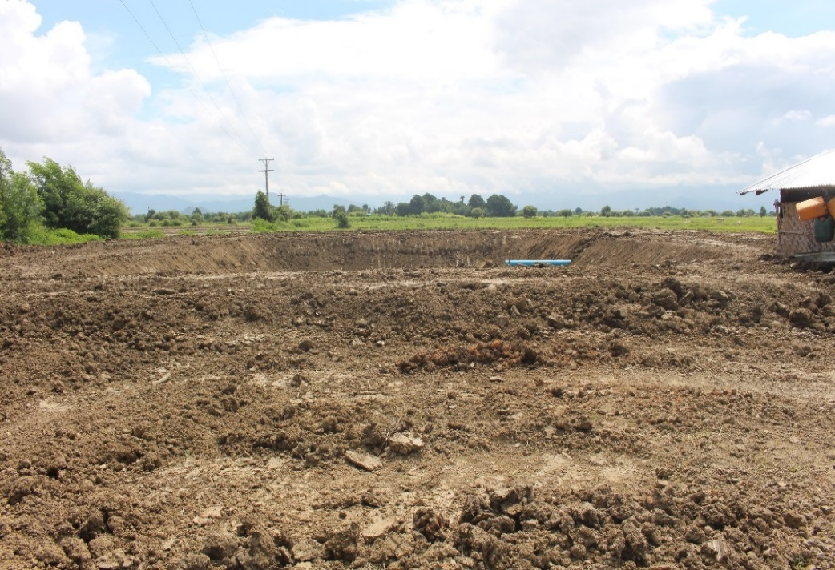
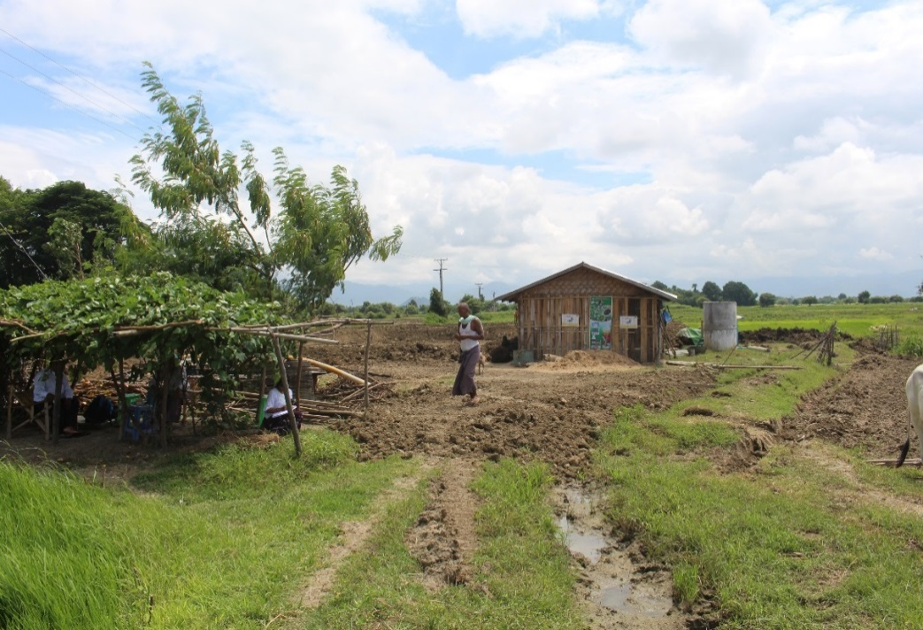
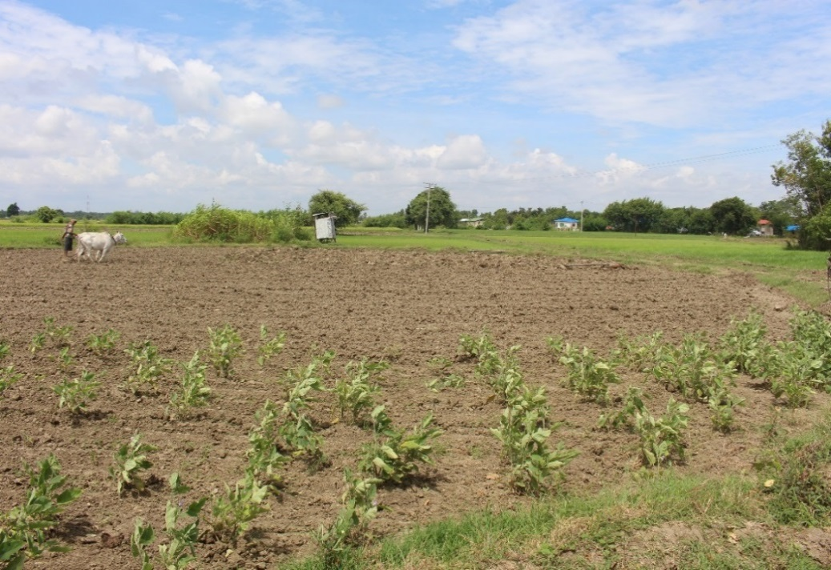
U Mg Myint’s Farm, Saegyi Village, Yamethin Township

Slide 14
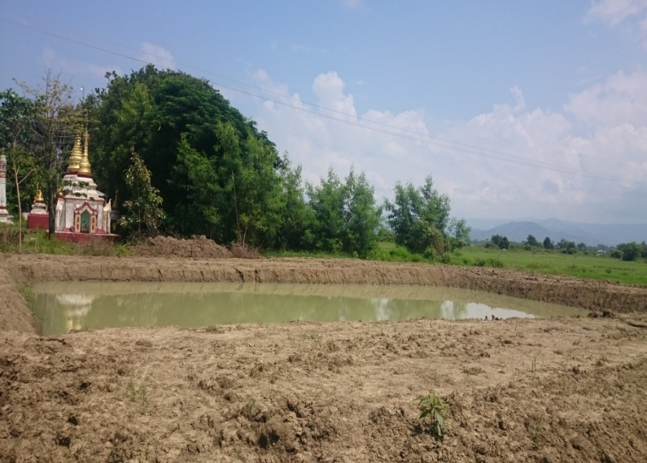
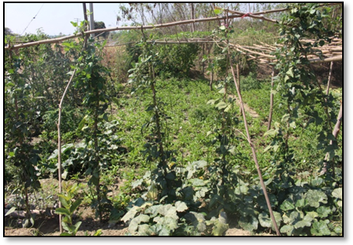
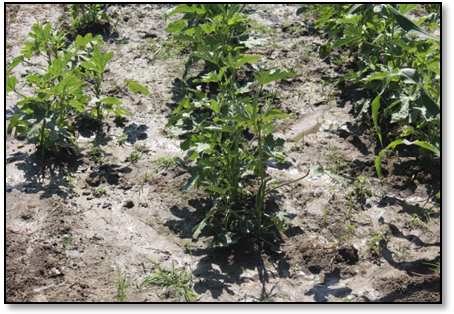
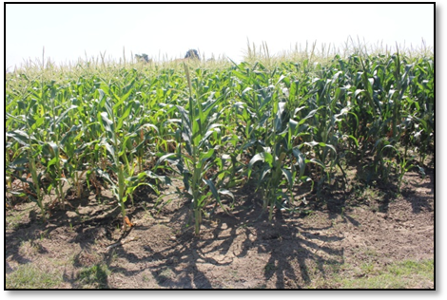
U Mg Myint’s Farm, Saegyi Village, Yamethin Township

Slide 15
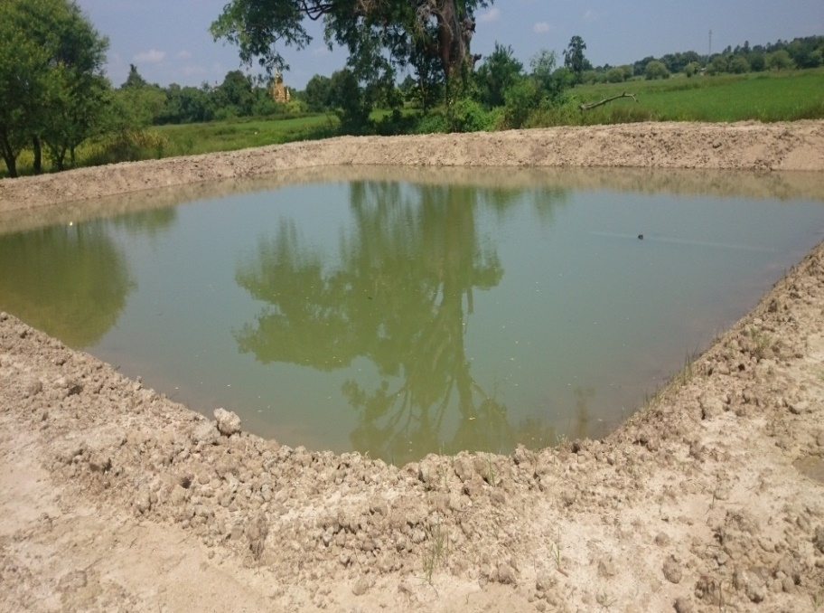
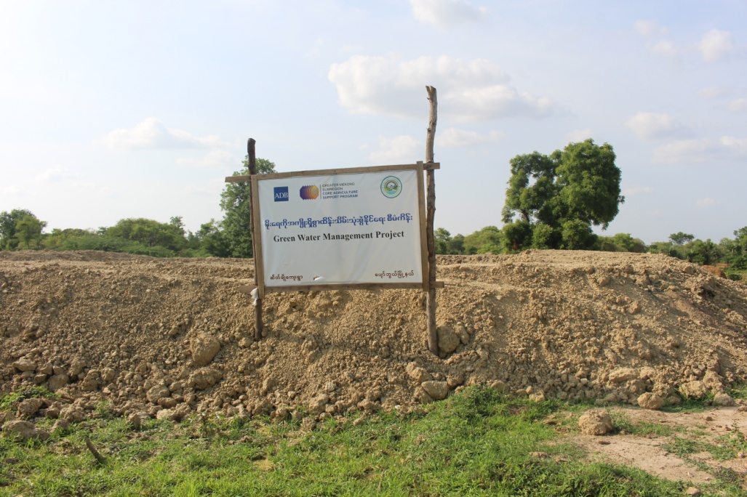
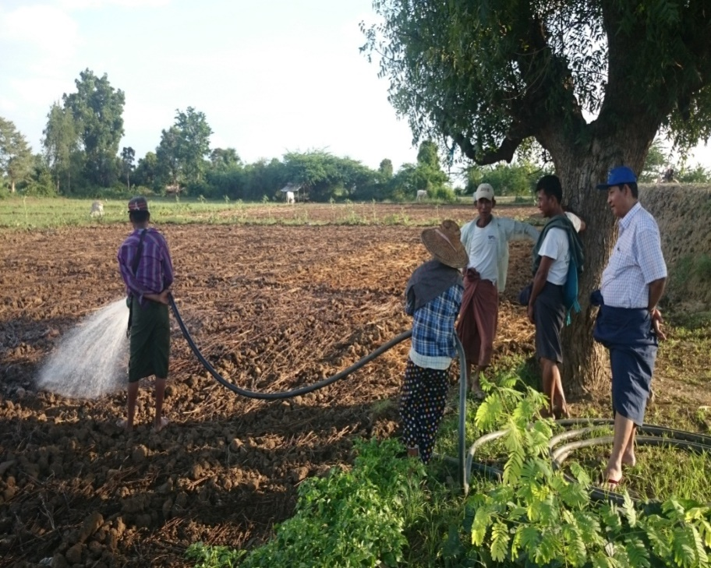
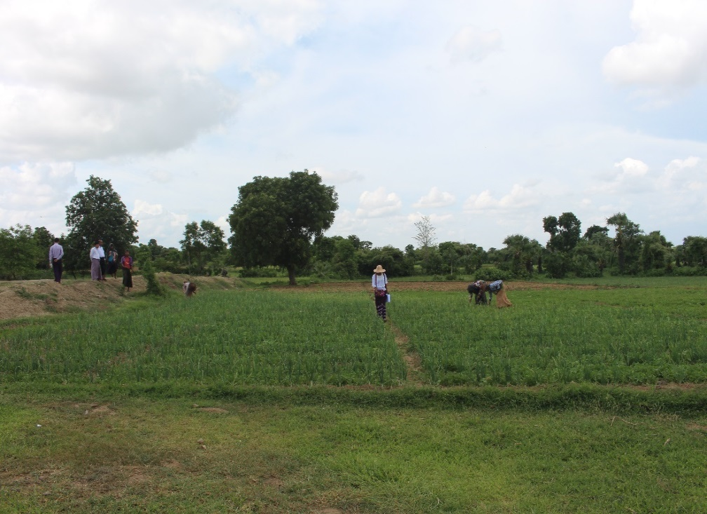
Daw Tin Tin’s Farm, Satcho Village, PyawbweTownship

Slide 16
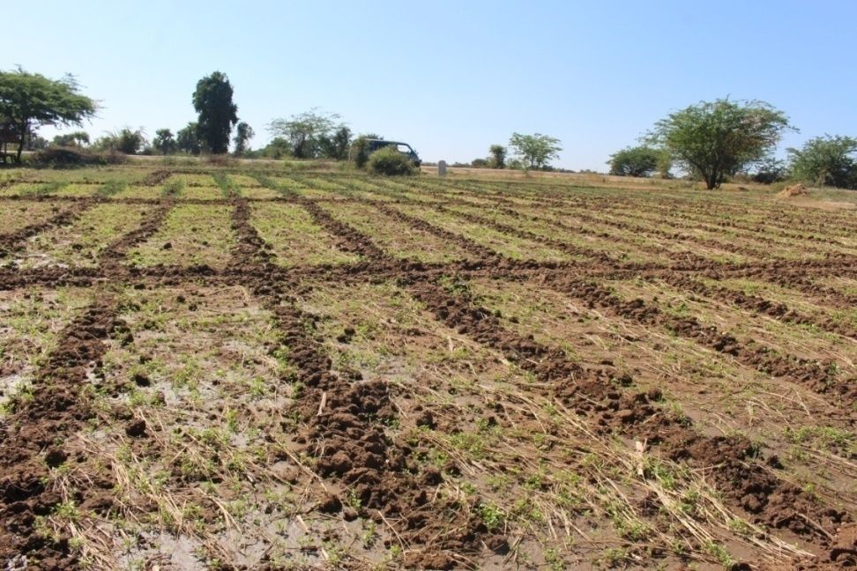
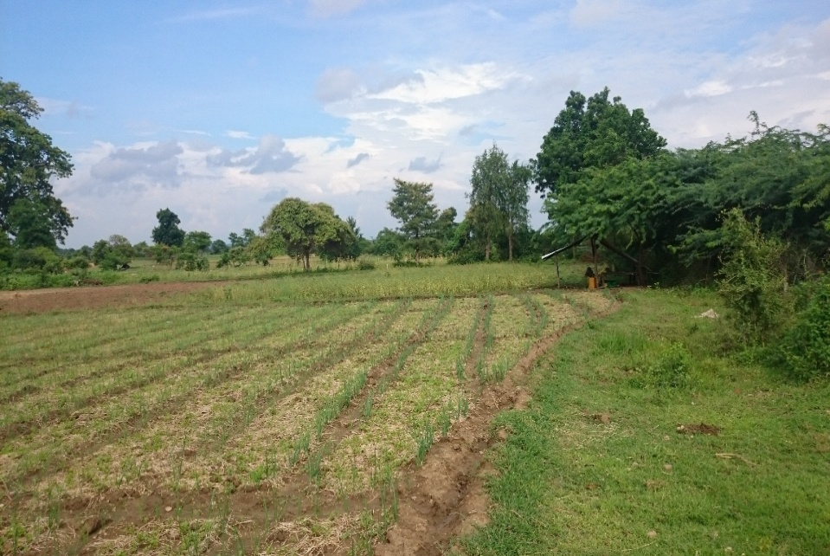
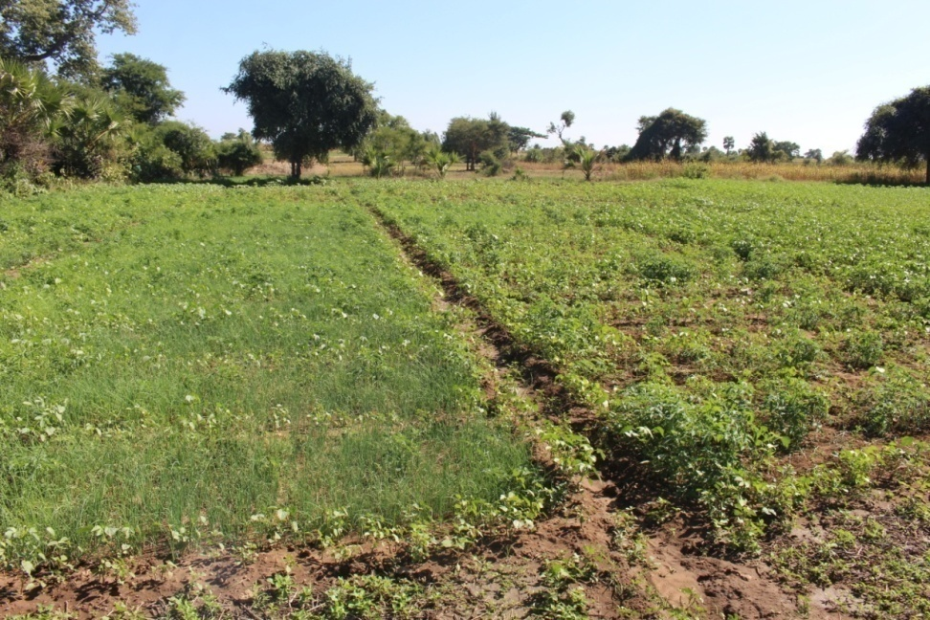
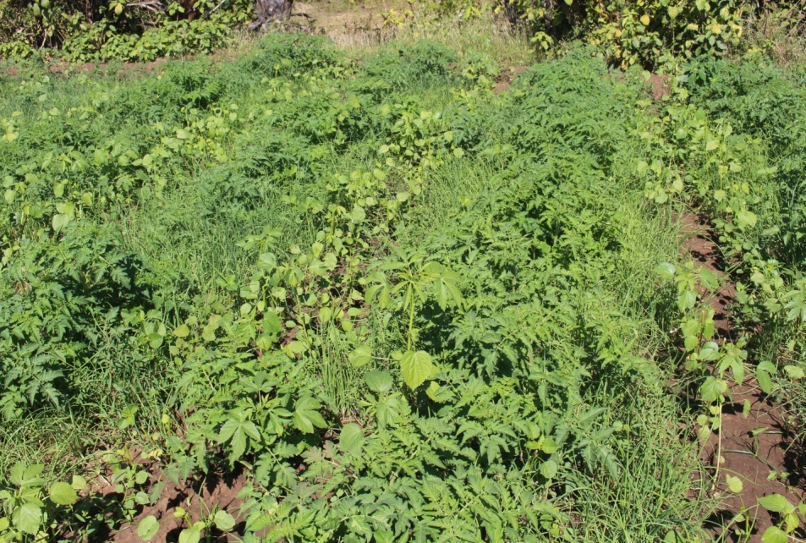
Daw Tin Tin’s Farm, Satcho Village, Pyawbwe Township

Slide 17
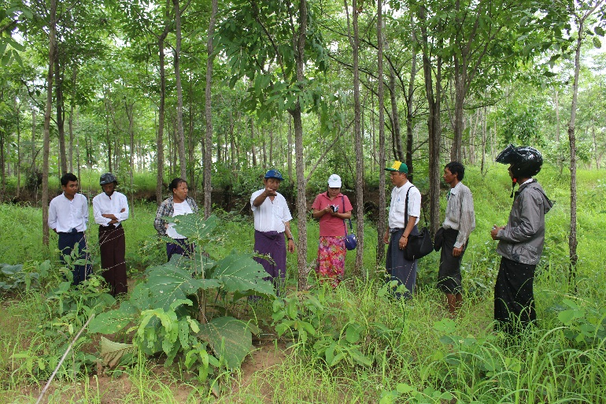
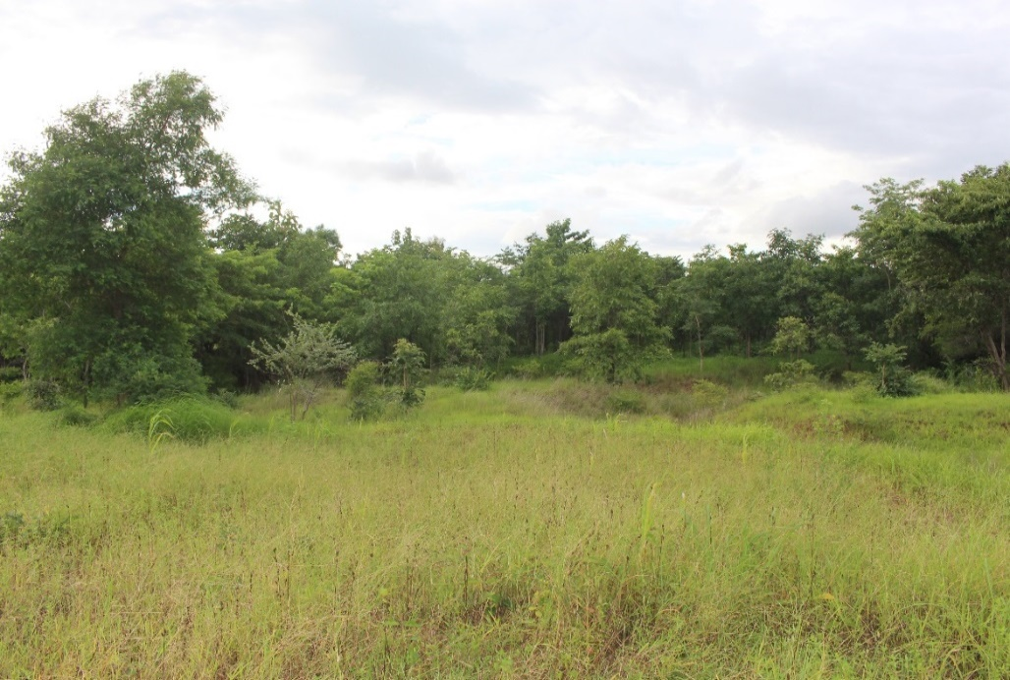
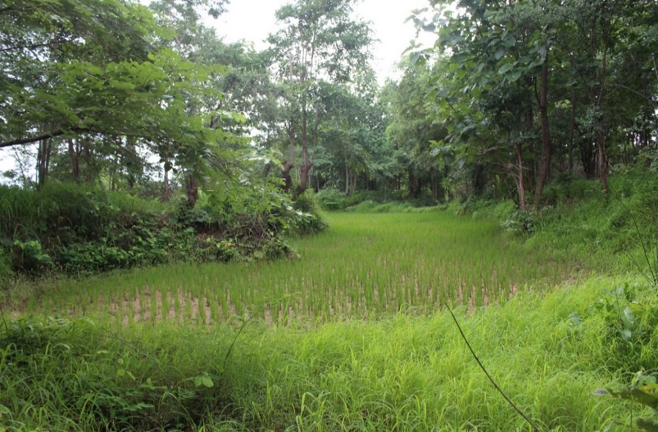
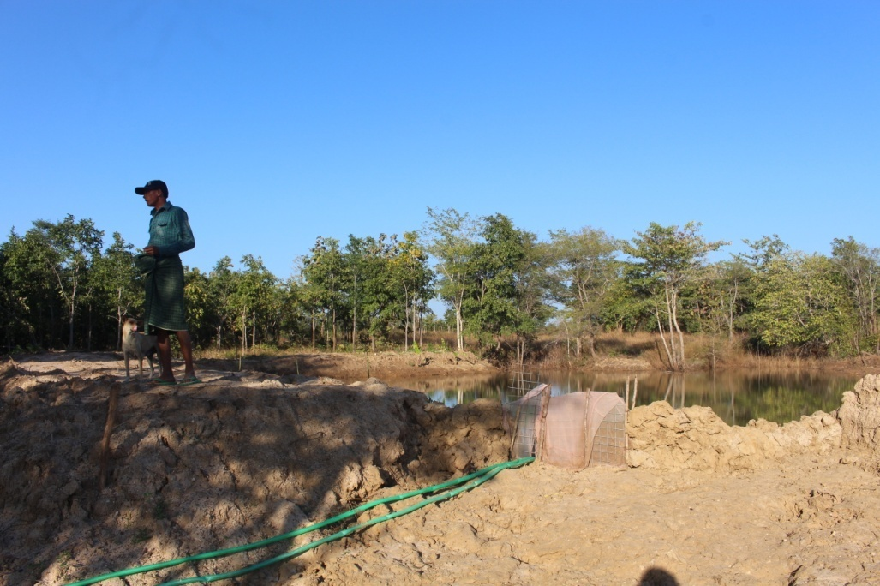
U Kyaw Soe’s Farm, Nakyarhtoo Village, Natmauk Township

Slide 18
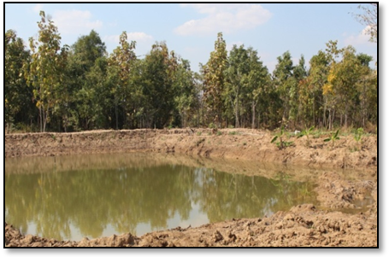
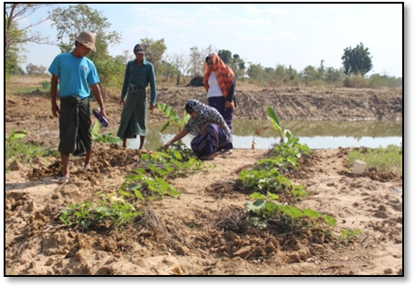
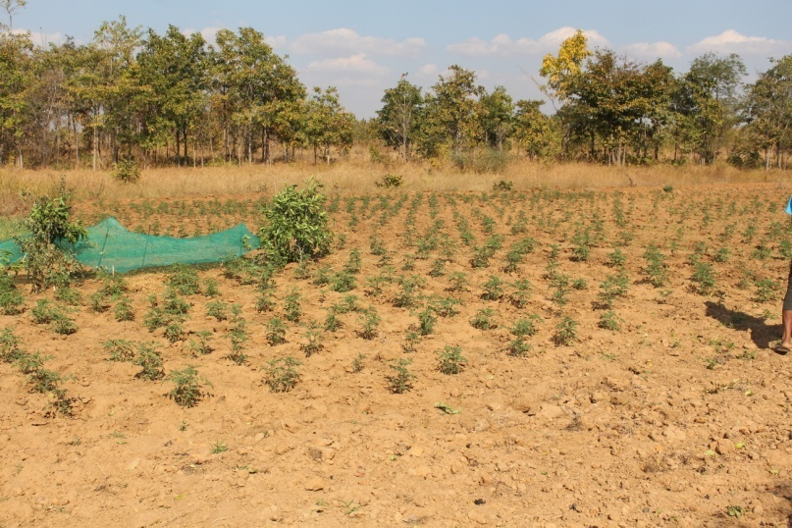
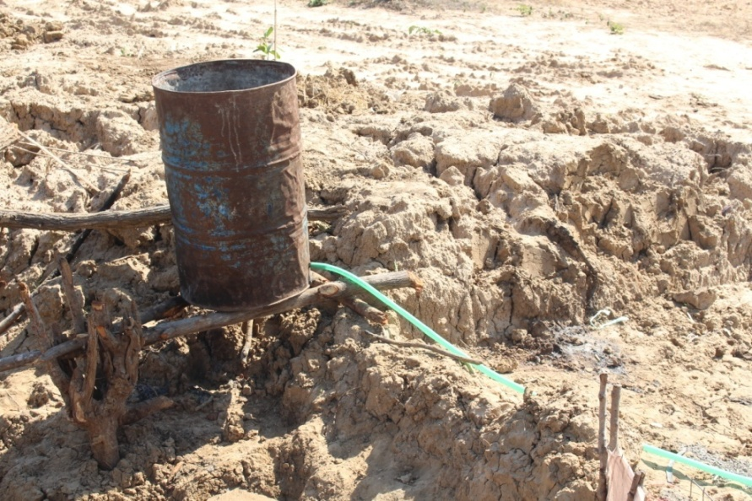
U Kyaw Soe’s Farm, Nakyarhtoo Village, Natmauk Township

Slide 19
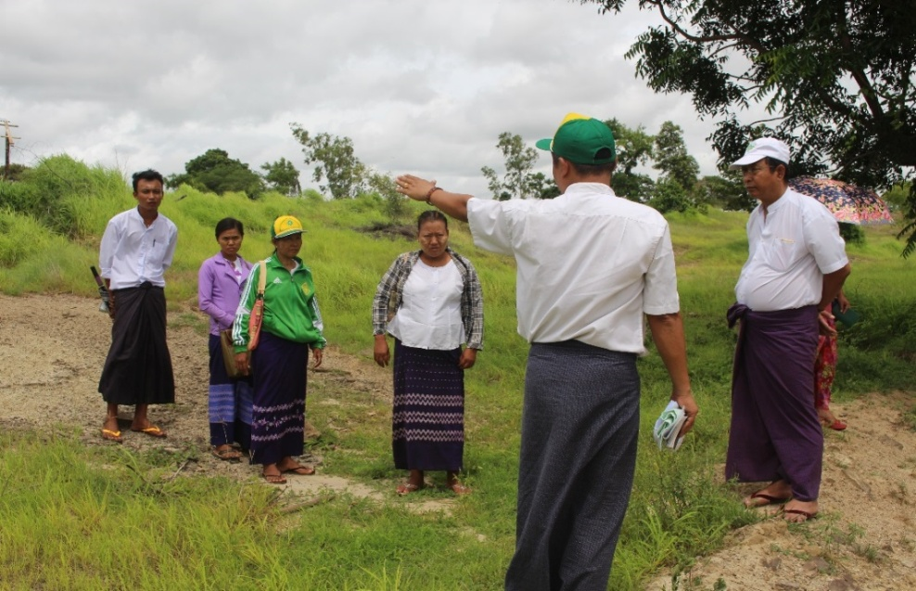
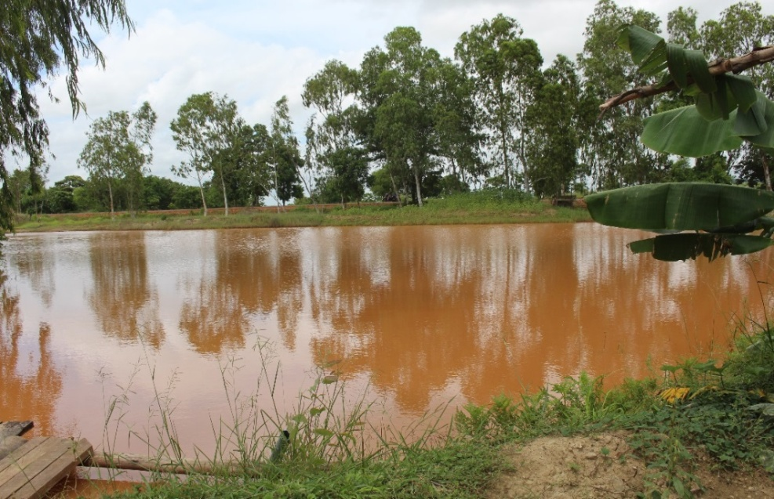
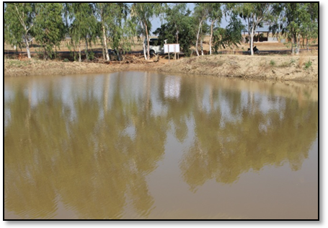
U Thein Hlaing’s Farm, Shwekwe Village, Natmauk Township

Slide 20
U Thein Hlaing’s Farm, Shwekwe Village, Natmauk Township

Slide 21
Daw Myint2 Mu’s Farm, Thanngone Village, Myothit Township

Slide 22
Daw Myint2 Mu’s Farm, Thanngone Village, Myothit Township

Slide 25
Training Workshop on participatory Monitoring and Evaluation of the Project in November 29- December 2, 2016 at Nay Pyi Taw

Slide 26
ToT training on Green Water Management Project at CARTC, Hlegu Township

Slide 27
Training of farmers on Green Water Management at Saegyi Village, Yamethin Township

Slide 28
Training of farmers on Green Water Management at Saegyi Village, Yamethin Township

Slide 29
Training of GWM for Staffs

Slide 30
Participatory Guarantee System Training in Natmauk and Myothit Townships

Slide 31
Participatory Guarantee System Training in Yamethin and Pyawbwe Townships

Slide 32
Training in Yamethin Township

Slide 33
Training in Natmauk Township

Slide 34
Training in Natmauk Township

Slide 35
Training in Myothit and Natmauk Townships

Slide 36
Dr. Apichai’s Mission in Myothit and Natmauk Townships

Slide 37
Supporting Trees and EM to Demo farmers

Slide 38
EM bokachi compost making in the Demo farms

Slide 39
Supporting Organic-fertilizers to Demo- farmers

Slide 40
Key Issues/Problems/Constraints/Challenges during implementation and Corrective Actions:
Implementation Issue encountered | Intervention and Recommendation
Without water pumping systems | Support water pumping systems
Little experience raising fish | Contact to Fishery Department
Water losses by evaporation | Use natural floating cover systems (such as growing of water plant)
Late constructing of water pond | Make early construction before rainy season
Low experiences of farmers in vegetable plantation | Support training more about vegetable production

Slide 41
Water Cress Plantation and Solar Pumping System

Slide 42
Pilot farmers in Pyawbwe Township

Slide 43
Follow-up Activities
Building farmer knowledge centres
Access to market for CFA products established
Farmer field days and exchange visits
Construction of water pump system in Tatkone Township
Conduct policy assessment on CFA including GWM
One national workshop to be organized to disseminate outcome of the project to stakeholders and share the best practices

Slide 44
Expected Outcome
Increased climate friendly agricultural (CFA) practices adopted, soil quality improved and income of small holder farmers.
By end of project,
Percentage of CFA farmers increased 30% in target village area (at least 30% of which are managed by female);
Yield of CFA products increased at least 20% compared to conventional practices;
Frequency of watering crops reduced by at least 20%;
Population of soil worms increased by 20% compared to conventional farms; and
Income of small holder farmers who adopted CFA practices increased by 30%
Notes:
By end of project, the results will be compared to September 2016 baseline survey:

Slide 45
Expected Impact
The impact of Green Water Management project will be increased productivity, production and market access of climate friendly agriculture (CFA) products.

Slide 46
Thank you for your kind attention

