Slide 1
Implementation plan for Green Water Management Project in the dryland areas of Myanmar
TA-REG 8163
Implementation of Core Agriculture Support Program
Phase II (CASP 2) Activities under LOA in Myanmar
Project Implementation Unit (PIU)
Department of Agriculture (DOA)
Ministry of Agriculture Livestock and Irrigation Nay Pyi Taw
16.9.2016

Slide 2
Background
Vision of CASP 2 : For the GMS to be “recognized as the leading producer of safe food, using climate friendly agricultural practices and integrated into global markets through regional economic corridors”.
CAPS 2 : will implement from 2011 to 2020
Phase II (CASP 2): Total Budget US$ 150,000
LOA Signing
28 July 2016
Site Selection
August 2016 – September 2016
Inception Workshop
Project Implementation
August 2016 – September 2017

Slide 3
Objectives
To create green water management model in the dryland areas of Myanmar
To promote green water management awareness and best practices to local staffs and farmers through the efficient utilization of rainwater as supplementary water for the year round crops cultivation
To increase food security, food safety, households income and adaptive capacity of poor rural households to climate change and promote market linkages for smallholder farmers
To recommend policy makers for developing green water management in dryland areas of Myanmar

Slide 4
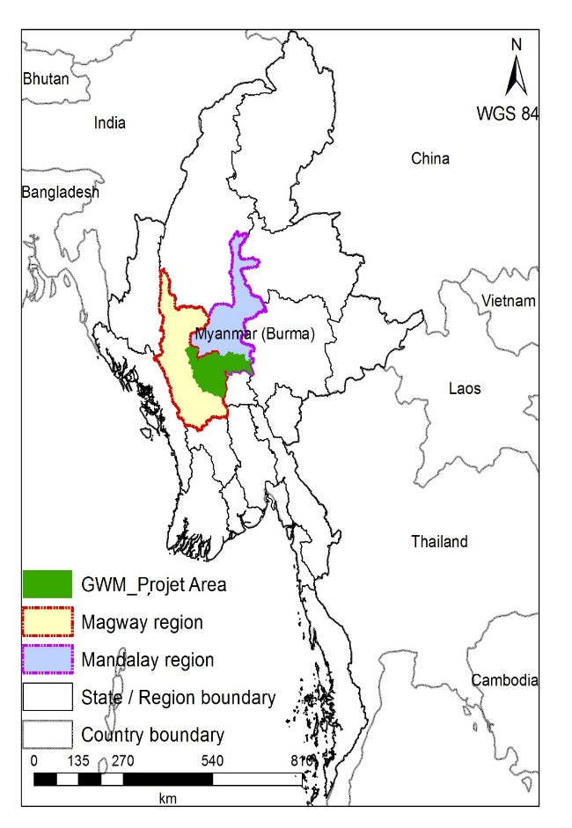
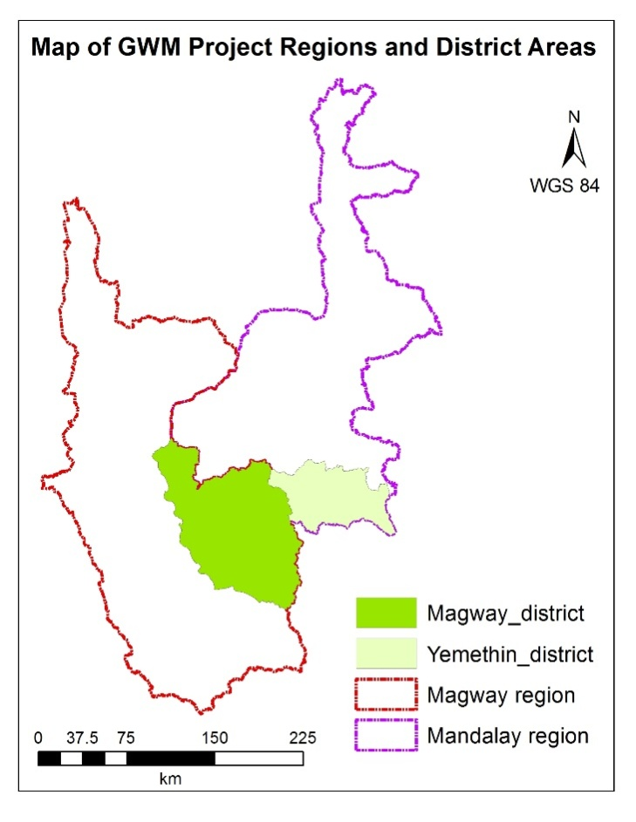
Map of Project Area

Slide 5
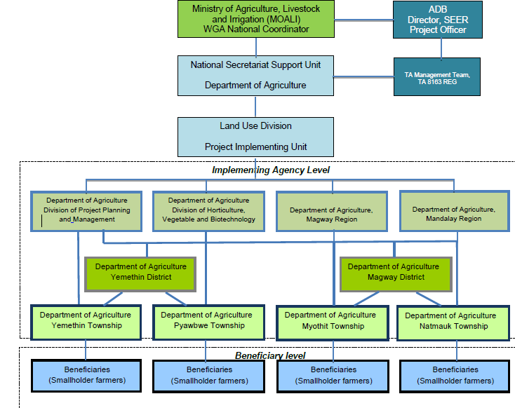
Project Implementation Arrangement

Slide 6
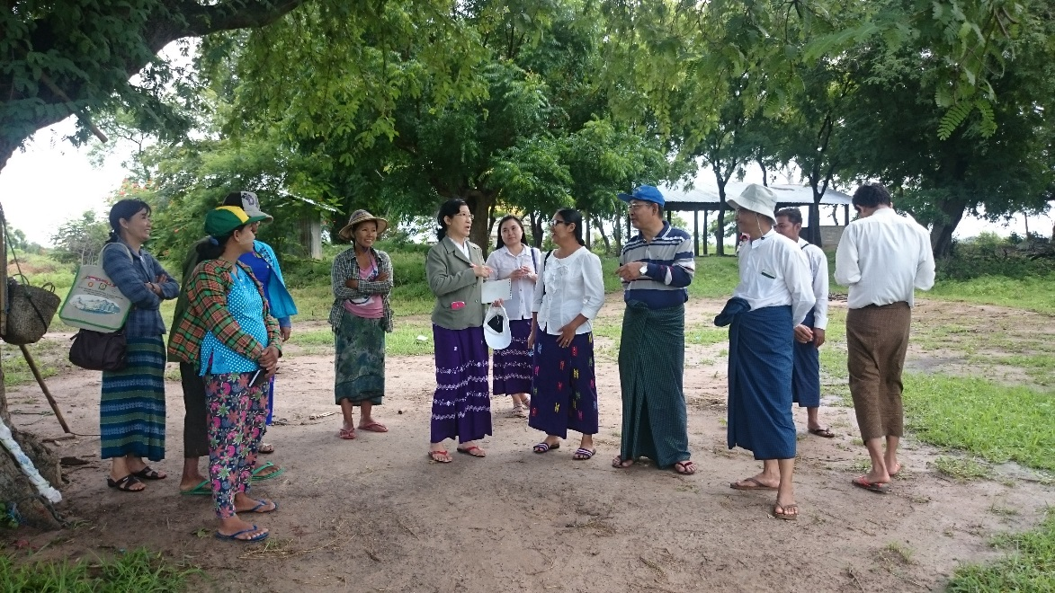
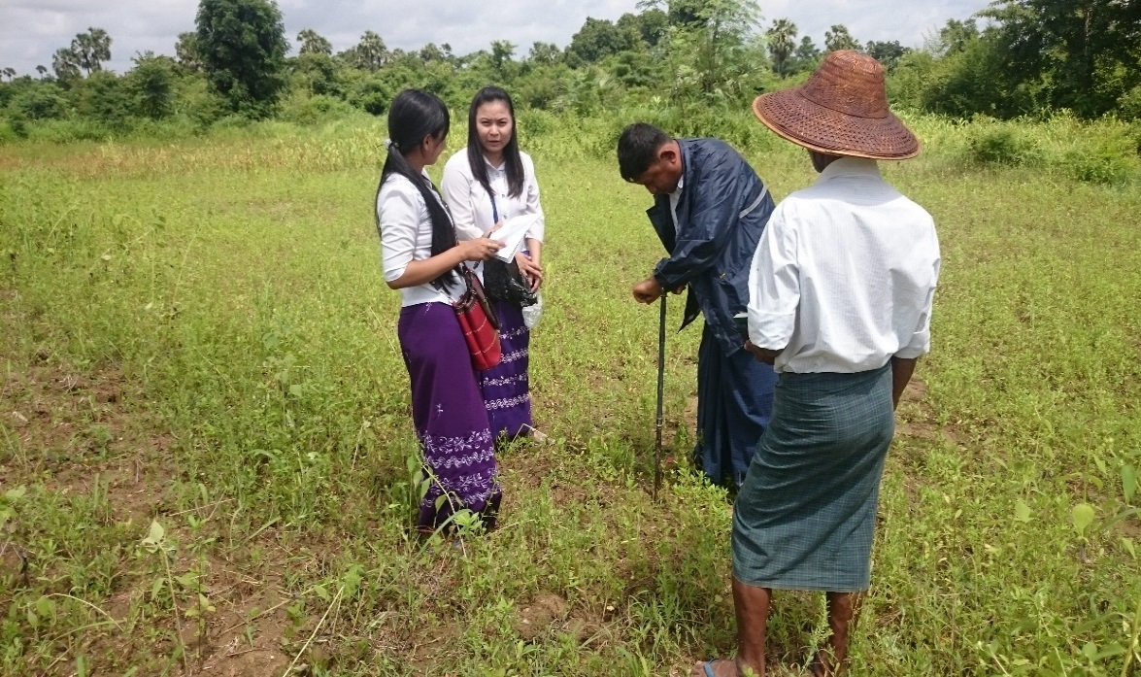
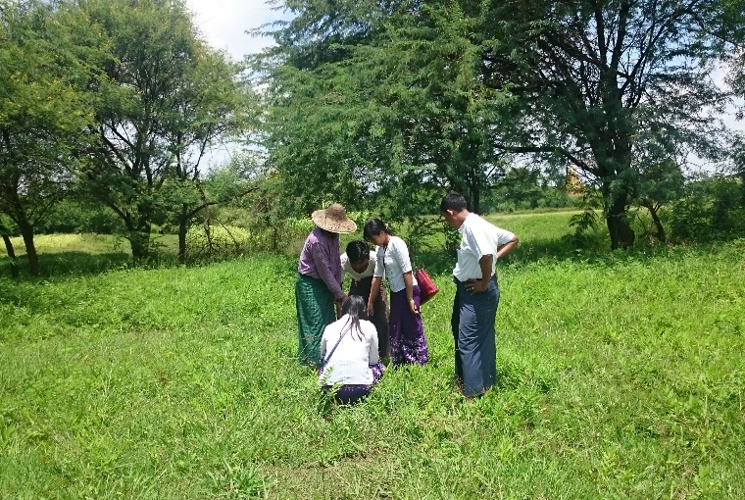
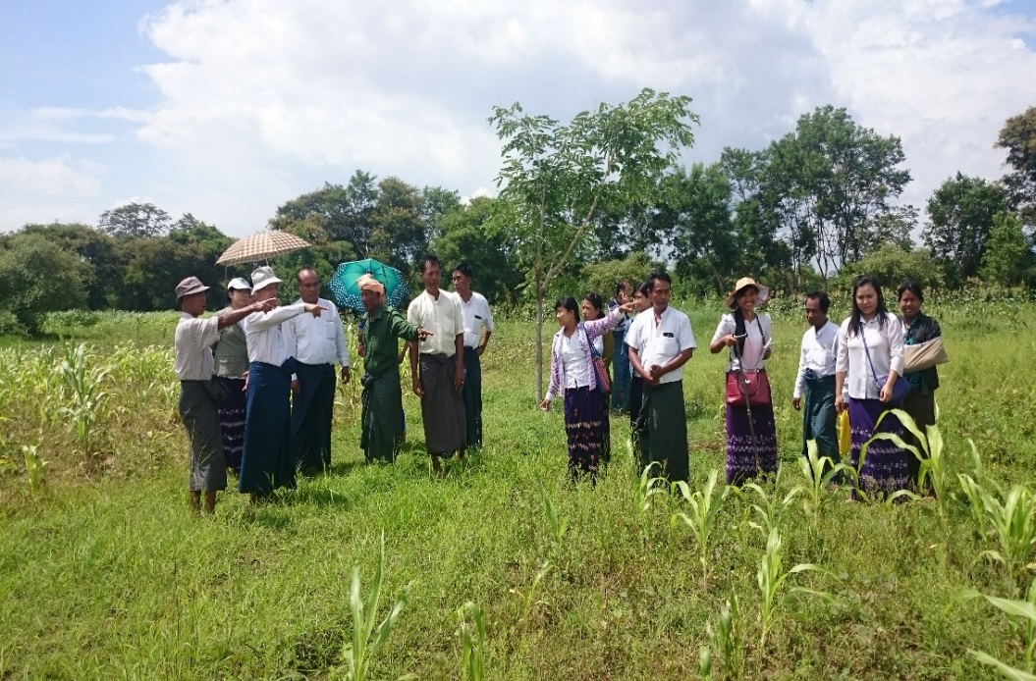
Field visit for Site Selection

Slide 7
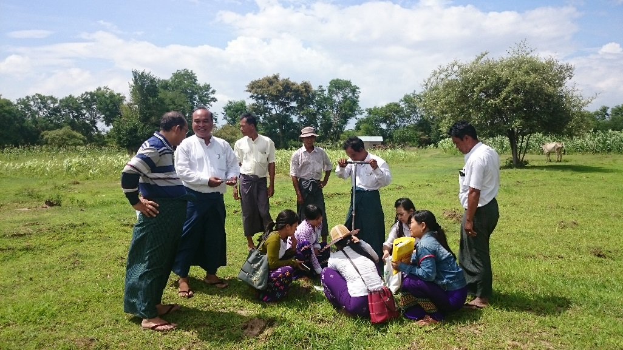
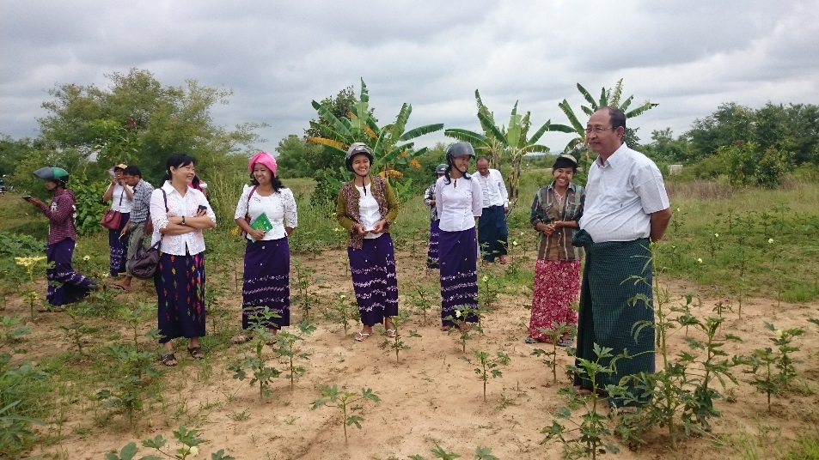
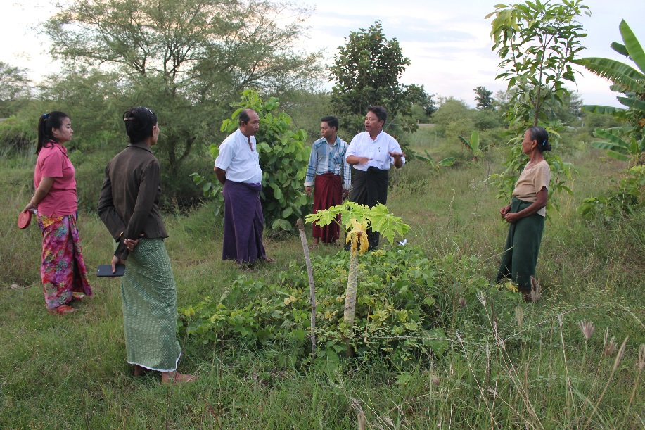
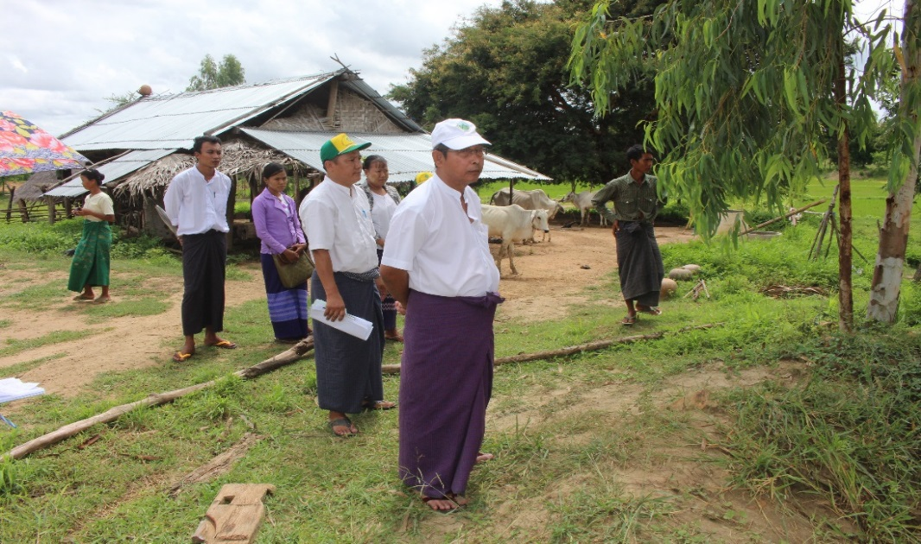
Field visit for Site Selection

Slide 8
List of target area, farm demonstration sites and pilot sites
Region | District | Township | Target Village | Total Population |  | Target beneficiaries | Target Demo farm | Target Pilot site
 |  |  |  | No. HH | No. person
Mandalay | Yemethin | Yemethin | Saegyi | 728 | 3625 | 50 | 1 | 1
Mandalay | Yemethin | Yemethin | Theingyone | 1645 | 7466 | 50 | 1 | 1
Mandalay | Yemethin | Pyawbwe | Satcho | 237 | 1440 | 50 | 1 | 1
Magway | Magway | Myo Thit | Thanngyone | 380 | 1698 | 50 | 1 | 1
Magway | Magway | Natmauk | Shwekwe | 162 | 678 | 50 | 1 | 1
Magway | Magway | Natmauk | Nakyarhtoo | 310 | 1408 | 50 | 1 | 1
Total | 2 Districts | 4 Townships | 6 villages | 3462 | 16315 | 300 | 6 | 6

Slide 9
Project target area and beneficiaries
Implementing Partner | Beneficiaries |  |  | Target Areas
 | Farmer | Gov't officer | Private Sector/ INGOs | Region | District | Township | Village
Department of Agriculture (DOA), Land Use Division, Division of Horticulture, Vegetable and Biotechnology, Division of Project Planning and Management, NSSU under Department of Planning, Department of Irrigation and Water Resources Utilization Management, International Rice Research Institute (IRRI), Australia Center for International Agriculture Research (ACIAR), Groupe-de-Recherche-el-d’-Exchanges-Technologique (GRET), Organization for Industrial, Spiritual and Cultural Advancement-International (OISCA) Myanmar, Myanmar Farmers Association (MFA), Myanmar Fruit, and Vegetable Producers and Exporters Association (MFVPEA), Shan Maw Myae Co. Ltd Other Private Sector | 300 | 200 | 7 | 2 | 2 | 4 | 6

Slide 10
Project Implementation Unit (PIU)
Responsibility
Guidance, supervision and implementation of project activities in respective project site
Supporting the GWM technologies and materials for demonstration farm as well as pilot farmers
Practically conducting the demonstration farms for green water management
Organized by
Land Use Division and Department of Agriculture

Slide 11
Organization of PIU
No. | Position | Designation | Number
1. | Team Leader | Director, Land Use Division, DOA | 1
2. | Team Coordinator | Land Use Division, DOA | 1
3. | Team Group | Deputy Director, District level, DOA Staff Officer, Township Level, DOA Deputy Staff Officer, DOA Deputy Assistant Staff Officer, DOA | 2 4 4 6

Slide 12
Project Implementation Body (PIB)
Responsibility
For implementing the project together with Demo farmers under the guidance of PIU.
Organized by
DOA extension staffs from respective townships

Slide 13
Subject Matter Specialist in Training Teams
Training Team will be collaborated with
Land Use Division
Plant Protection Division
Horticulture and Plant Biotechnology Division
Project Planning, Management and Evaluation Division

Slide 14
Monitoring and Evaluation
2-3 times during the implementation period in collaboration with a third party organization such as Yezin Agricultural University or other external associations

Slide 15
Reporting Schedule
No. | Type of Report | Implementation Period | Submission Date PIU to NSSU | Submission Date NSSU to ADB
1 | Inception report | July – Aug 2016 | 25 Aug 2016 | end of Aug 2016
2 | First progress report (August to December 2016) | Aug – Dec 2016 | 01 Jan 2017 | 15 Jan 2017
3 | Second progress report (January to June 2017) | Jan – June 2017 | 01 July 2017 | 15 July 2017
4 | Third progress report (July to September 2017) | July – Sept 2017 | 01 Oct 2017 | 15 Oct 2017
5 | Final completion report | Aug 2016 – Sept 2017 | 01 Nov 2017 | 15 Nov 2017

Slide 16
Planned activities
6 demonstration sites
Training for government officers (efficient utilization of rainwater, reducing agro-chemical use technologies and climate friendly agricultural practices)
50 trained officers will become as trainers
Training for 300 farmers (at least 25% women)
Supporting Biochar Kiln and other farm inputs
6 pilot projects (might be included about 20 pilot farmers)

Slide 17
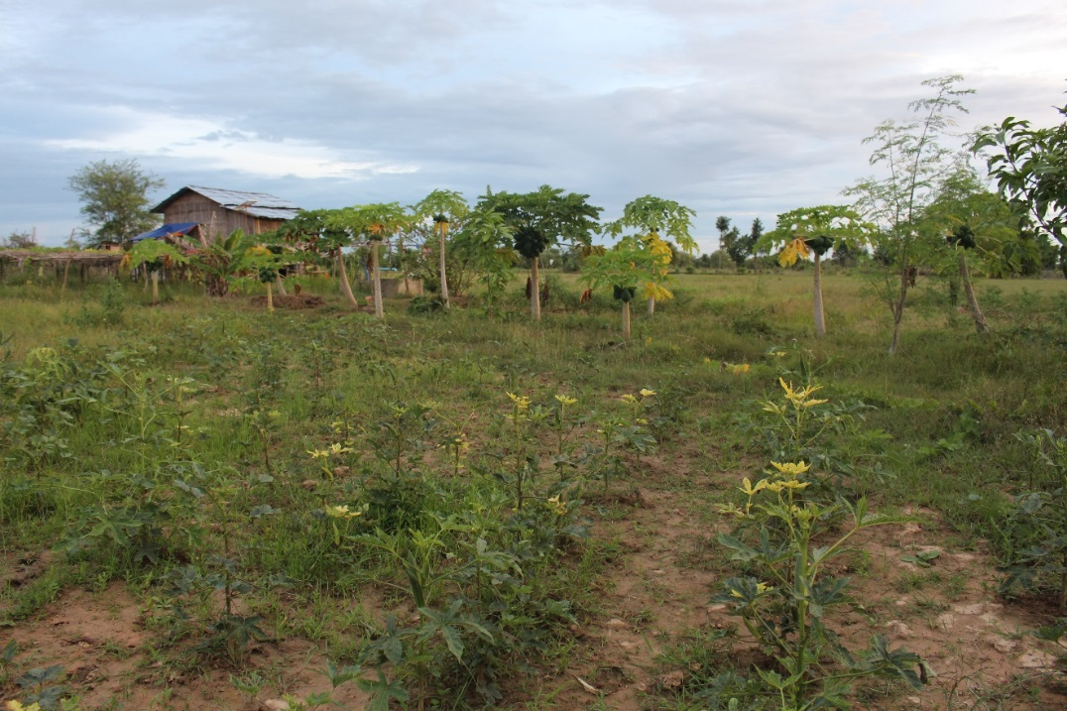
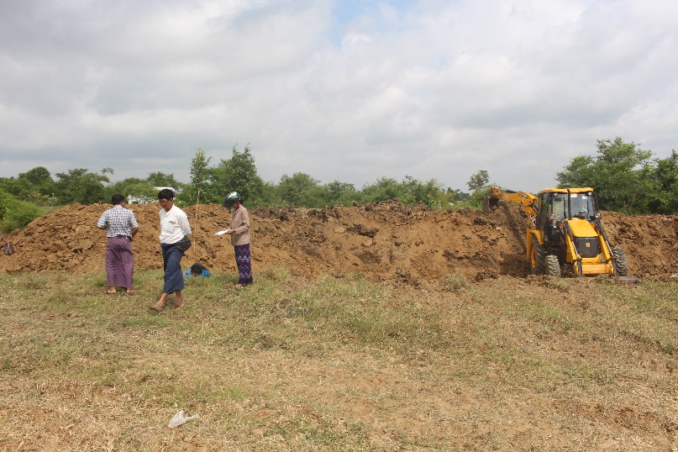
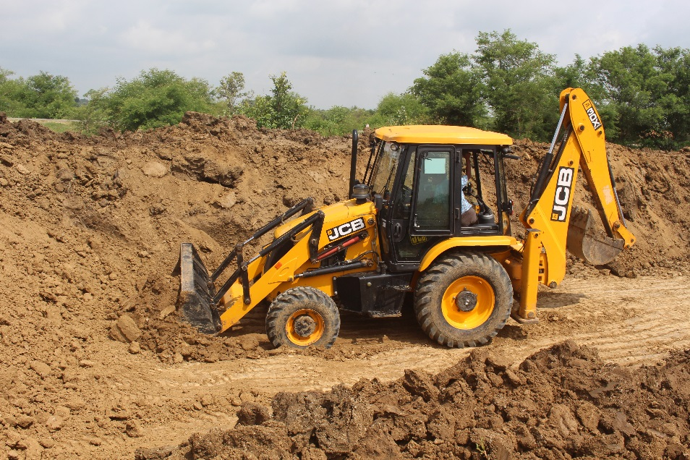
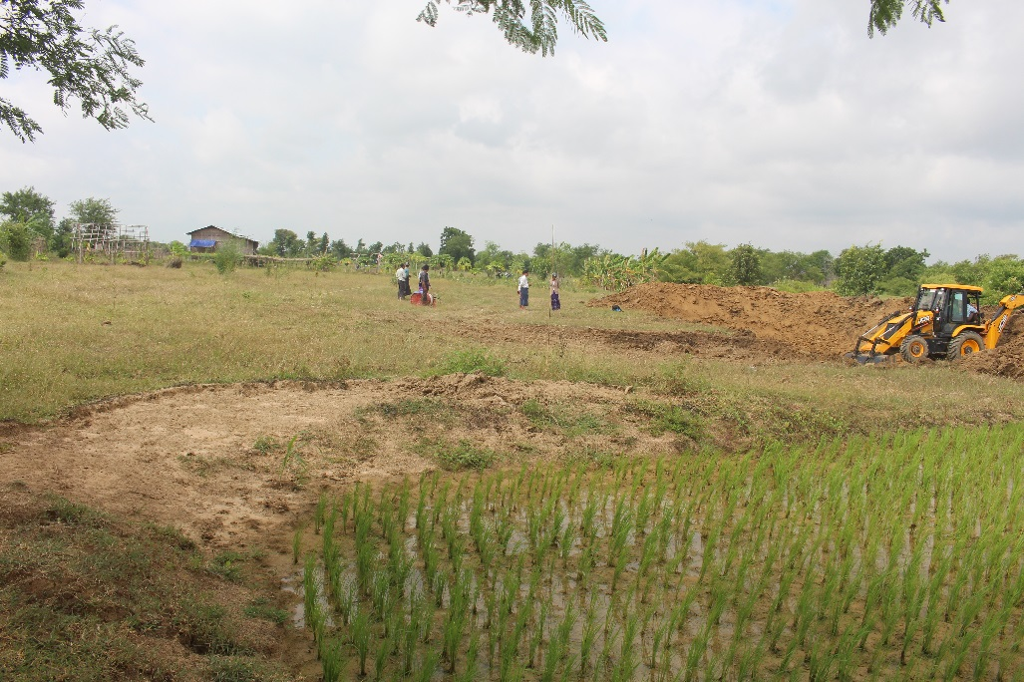
Ma Myint2 Mu’s Farm, Thangyone Village, Myothit Township

Slide 18
Model of GWM Demo Farm
Gliricidia or other trees
Farmer KC
Legume
Eggplant or Tomato
Papaya
Mango
Onion leaves
Paddy
Paddy
Water pond
Other vegetables
Notes:
Crop rotation

Slide 19
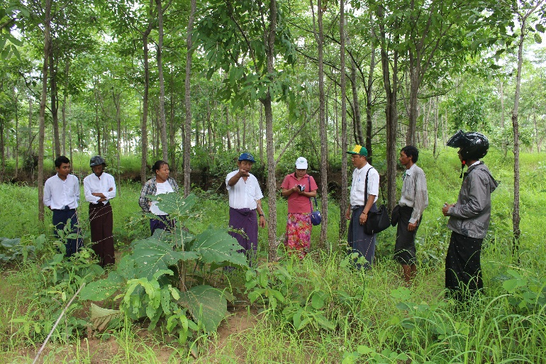
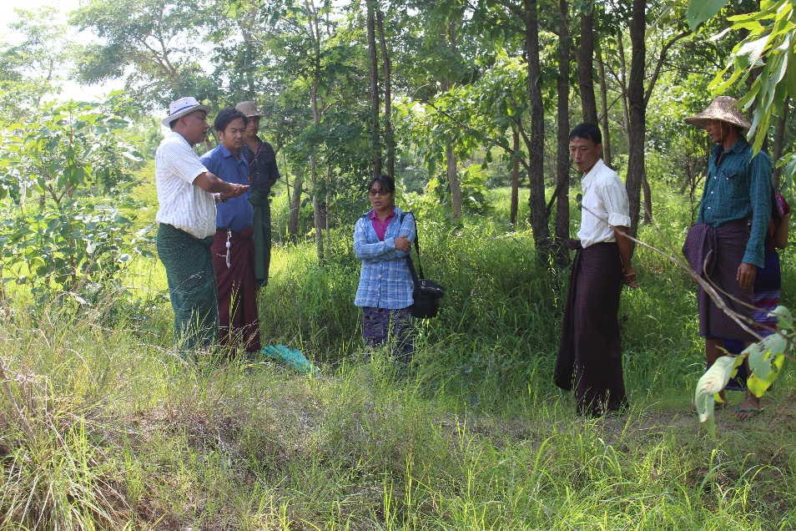
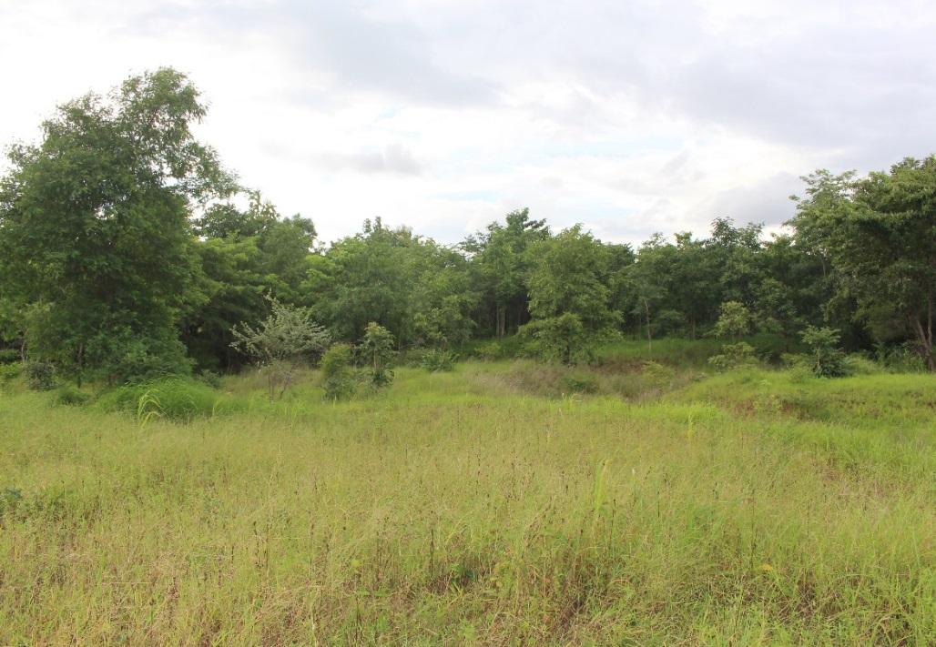
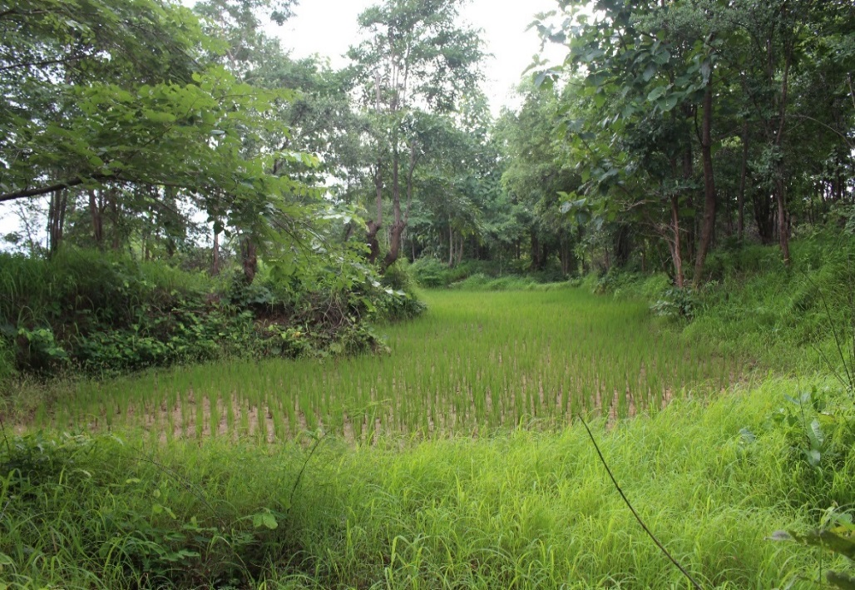
U Thein Aung’s Farm, Nakyarhtoo Village, Natmauk Township

Slide 20
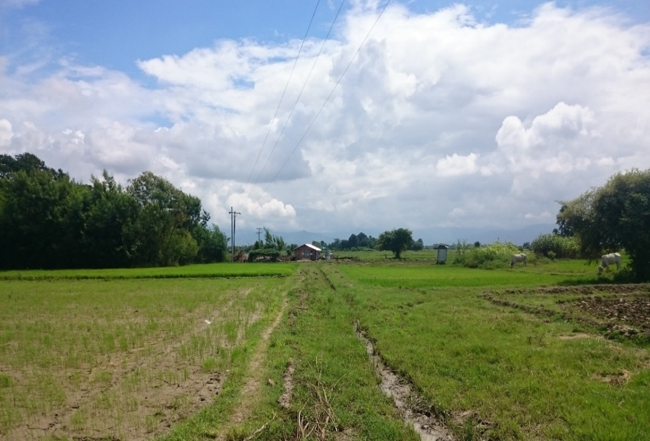
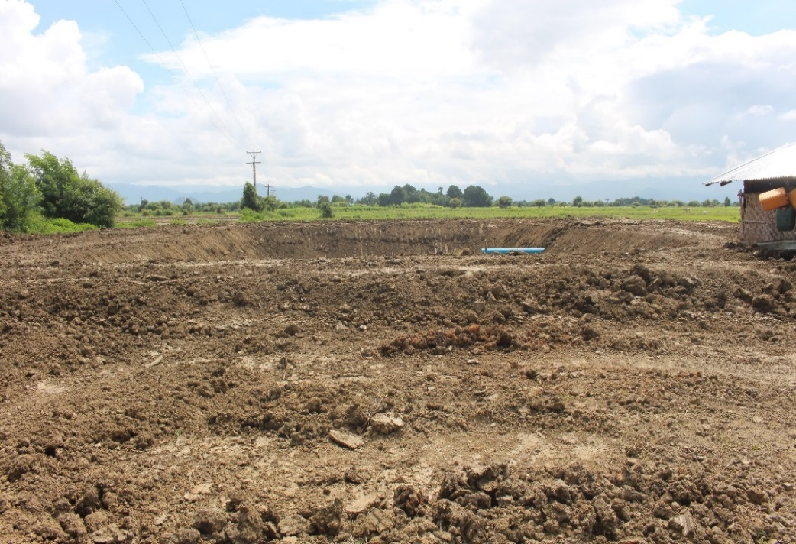
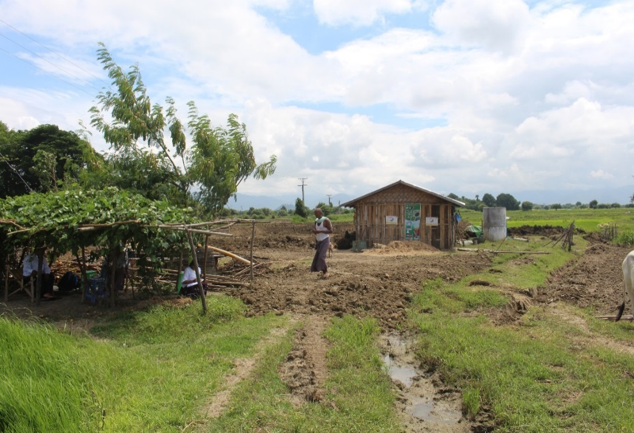
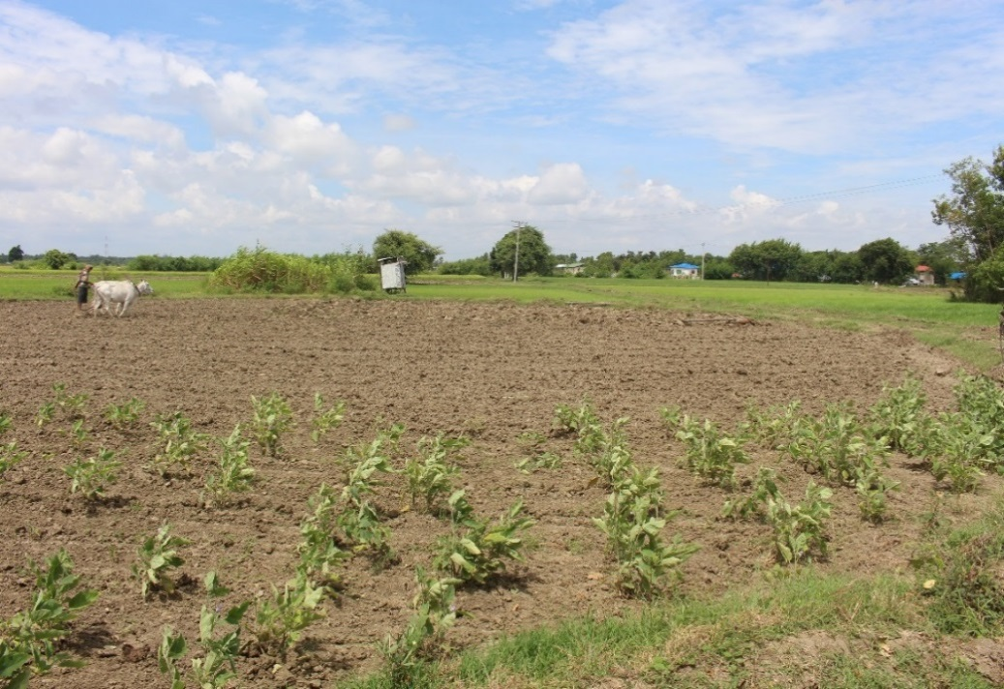
U Mg Myint’s Farm, Segyi Village, Yemethin Township

Slide 21
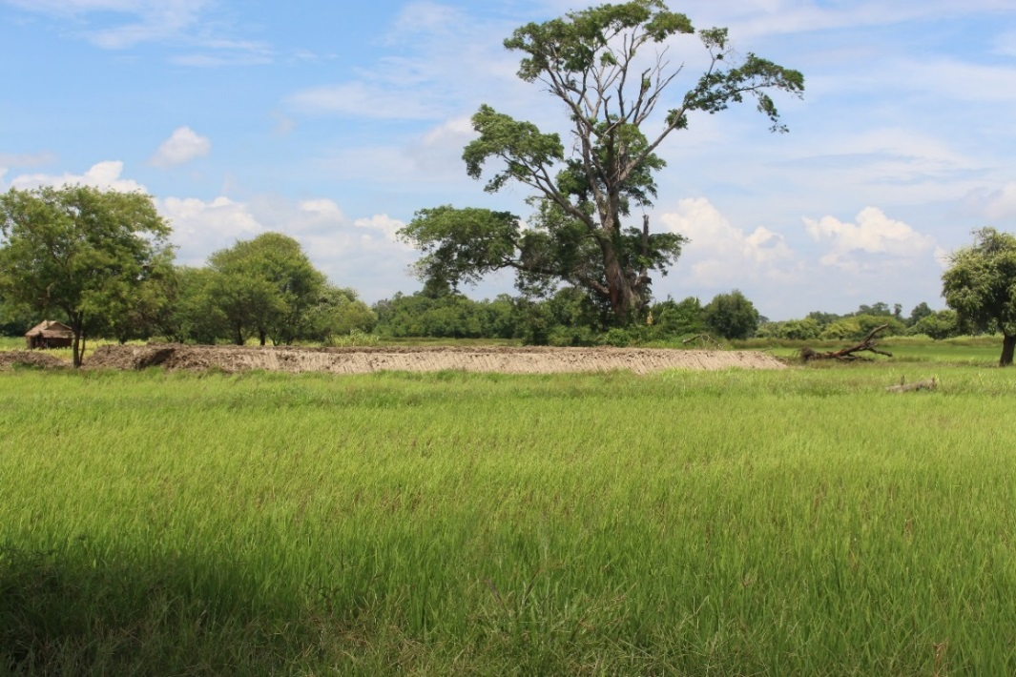
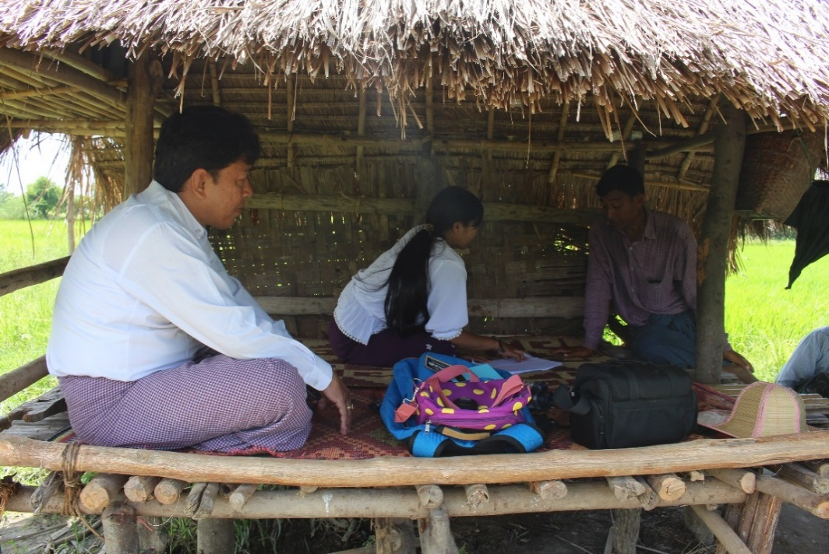
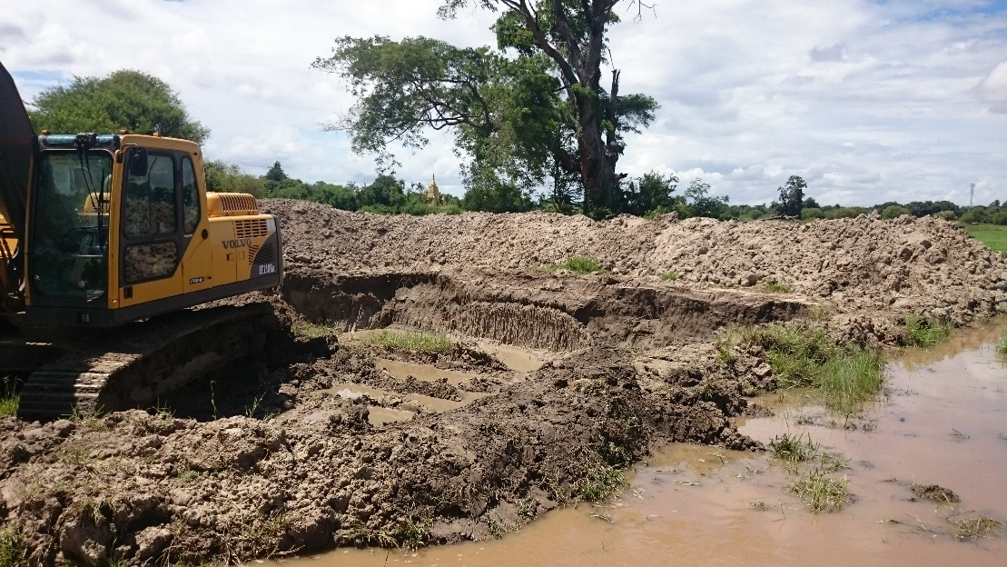
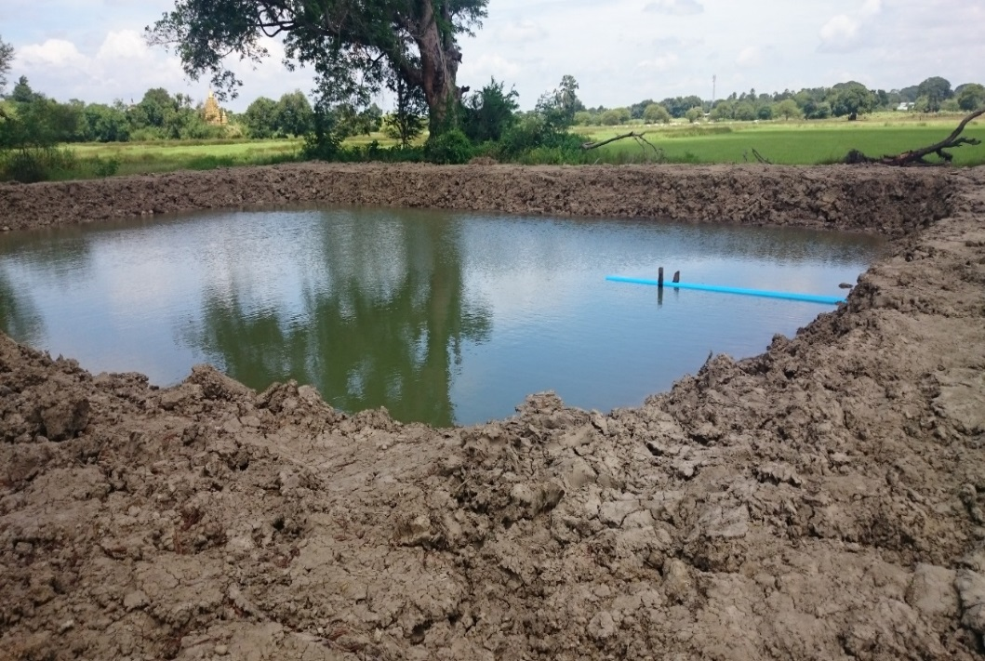
U Min Thet’s Farm, Theingyone Village, Yemethin Township

Slide 22
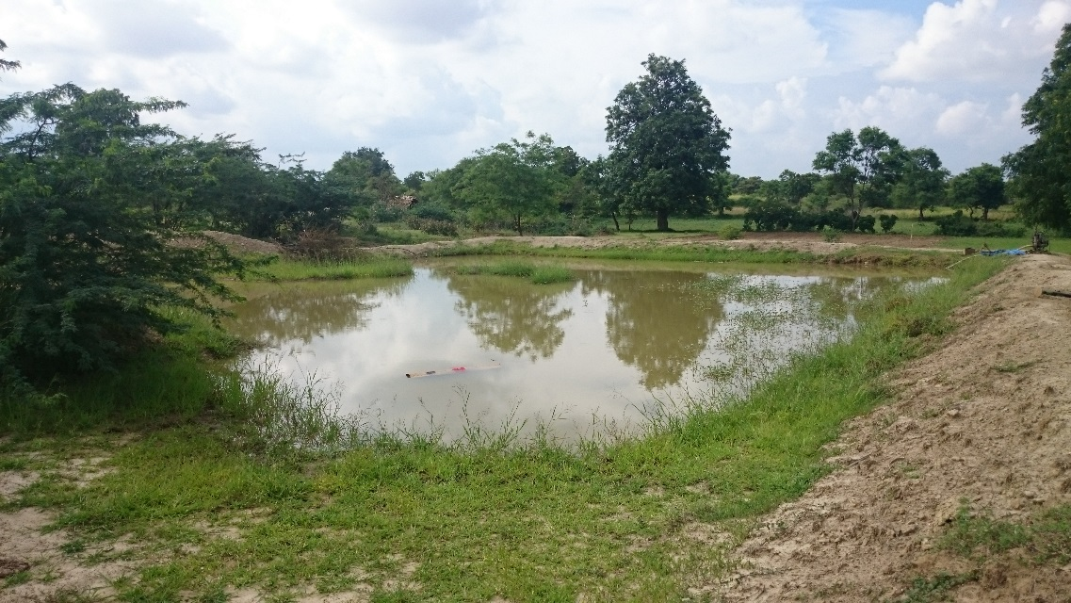
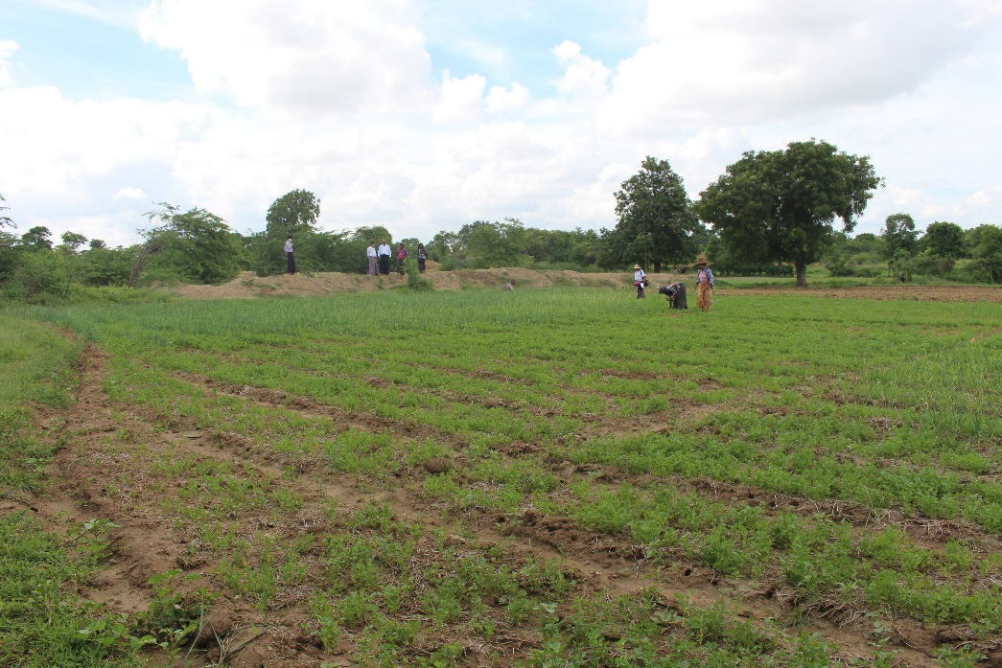
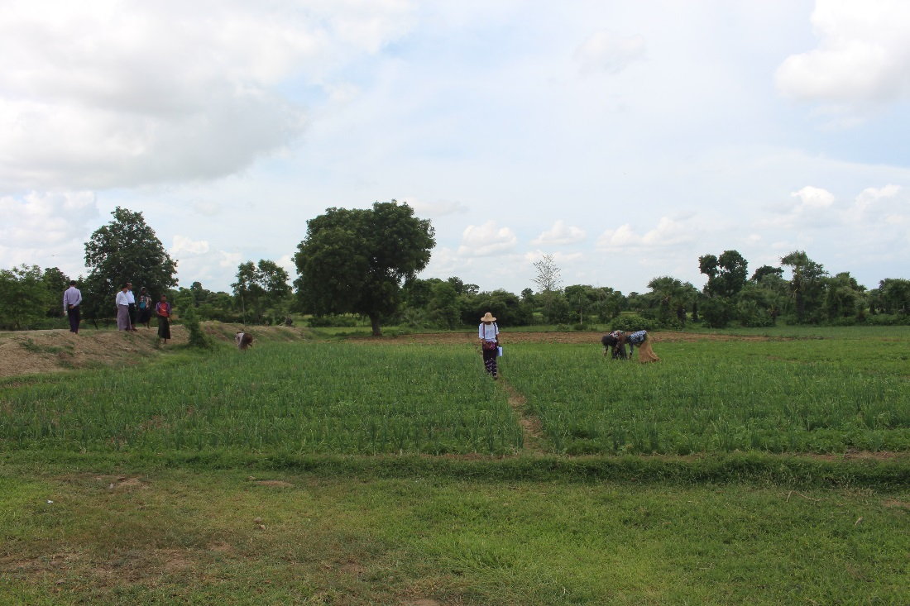
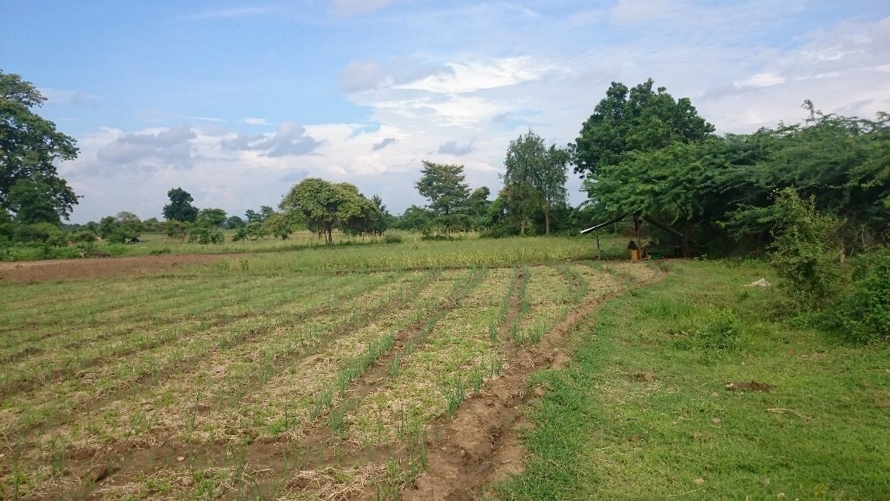
Daw Tin Tin’s Farm, Setcho Village, Pyawbwe Township

Slide 23
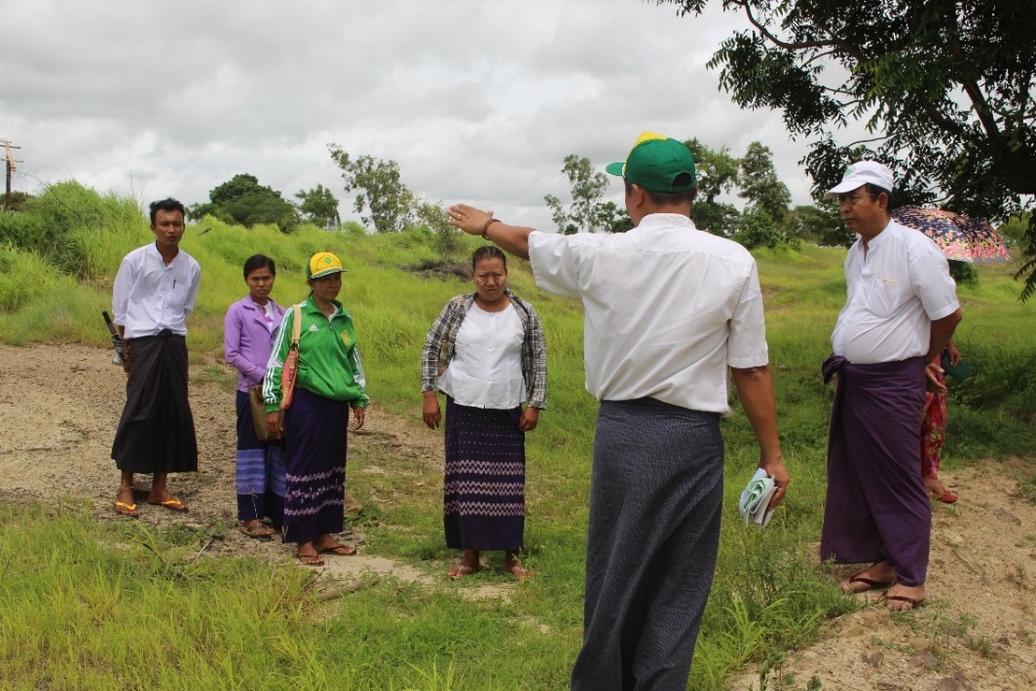
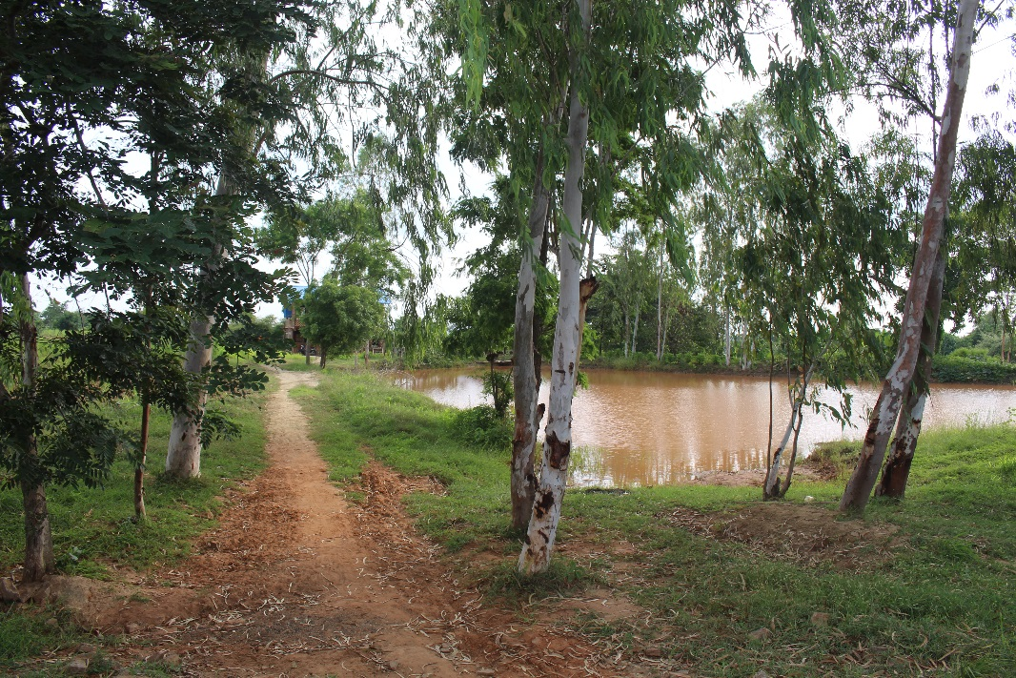
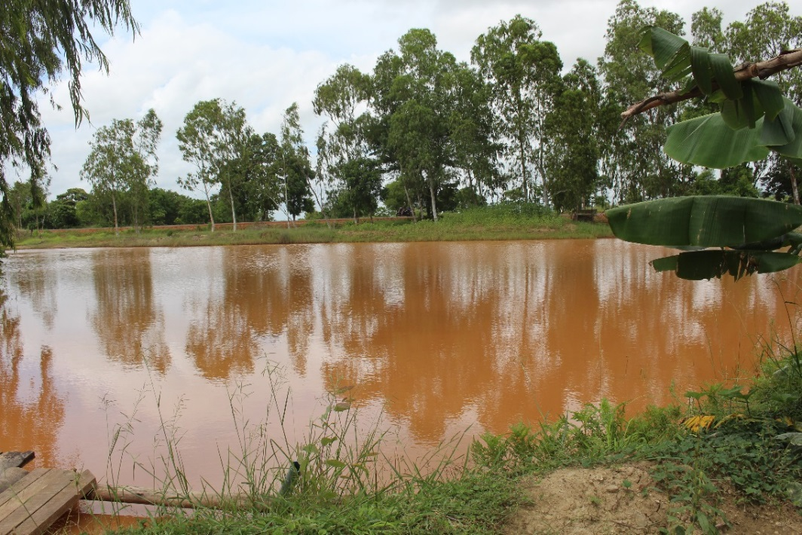
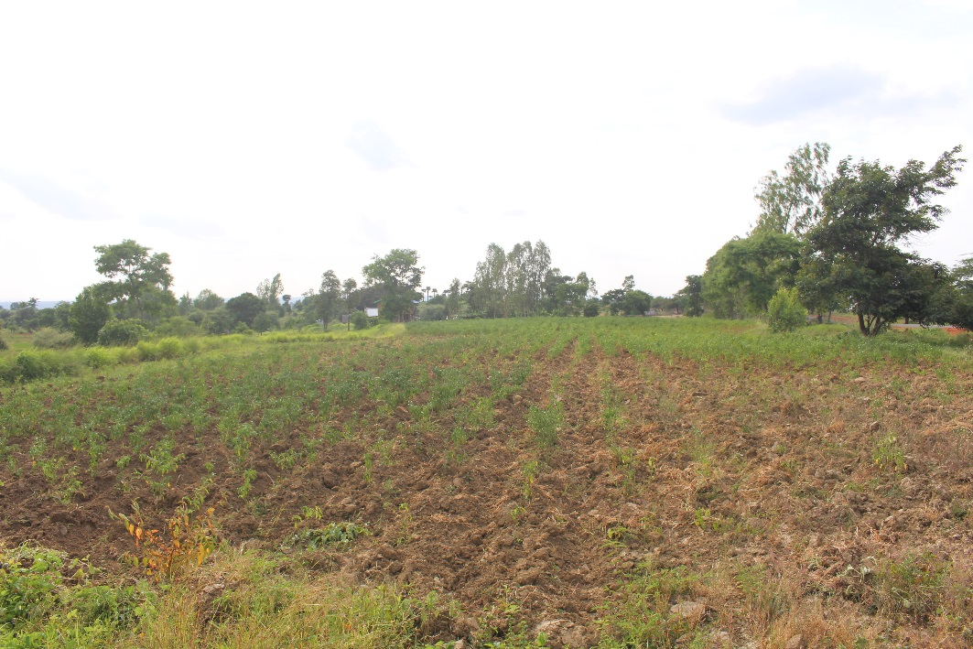
U Thein Hlaing’s Farm, Shwegwe Village, Natmauk Township

Slide 24
Planned Activities
Capacity building trainings
Building farmer knowledge centres
Farmer field days and field visits
Construction of water pump system

Slide 25
Capacity Building
For Demo-farmers
Green water management with climate friendly agriculture
Soil and water management practices
Good agricultural practices
Pre- and post- harvest technology
Introduction to participatory guarantee system

Slide 26
Capacity Building
For Department of Agriculture (DOA) staffs:
Training to trainer for staffs from DOA on GWM through organic farming techniques and PGS
Project Management & Monitoring
Visit to six demo and pilot farms and discuss with demo and pilot farmers and other interested persons

Slide 27
Supporting from the Project for the Farmers
Materials and inputs for demonstration farm
Materials for demonstration of GWM, solar pump, gliricidia or other trees, livestock and organic fertilizers such as Effective Microbes (EM) solution, Trichoderma, Dochekin, Vermiculture, Fish Amino Acid, Fermented Fruit Juice
Materials for botanical pesticides such as ginger, garlic, tobacco, plastic sheet, cow dung, rice bran

Slide 28
Supporting from the Project for the Farmers
Activities at Farmer Knowledge Centre
Training for capacity building with pamphlets, hand books, vinyl posters, power point presentations, video shows , discussion and the practical
Farmer Field Days
Field Visit to demo farms as well as other private farms

Slide 29
Planned activities
One national study and a report in English on policy support required on green water management and one national policy dialogue will be conducted
One national workshop to be organized to disseminate outcome of the project to stakeholders
Shared Myanmar’s best practices on green water management at the Regional Workshop

Slide 30
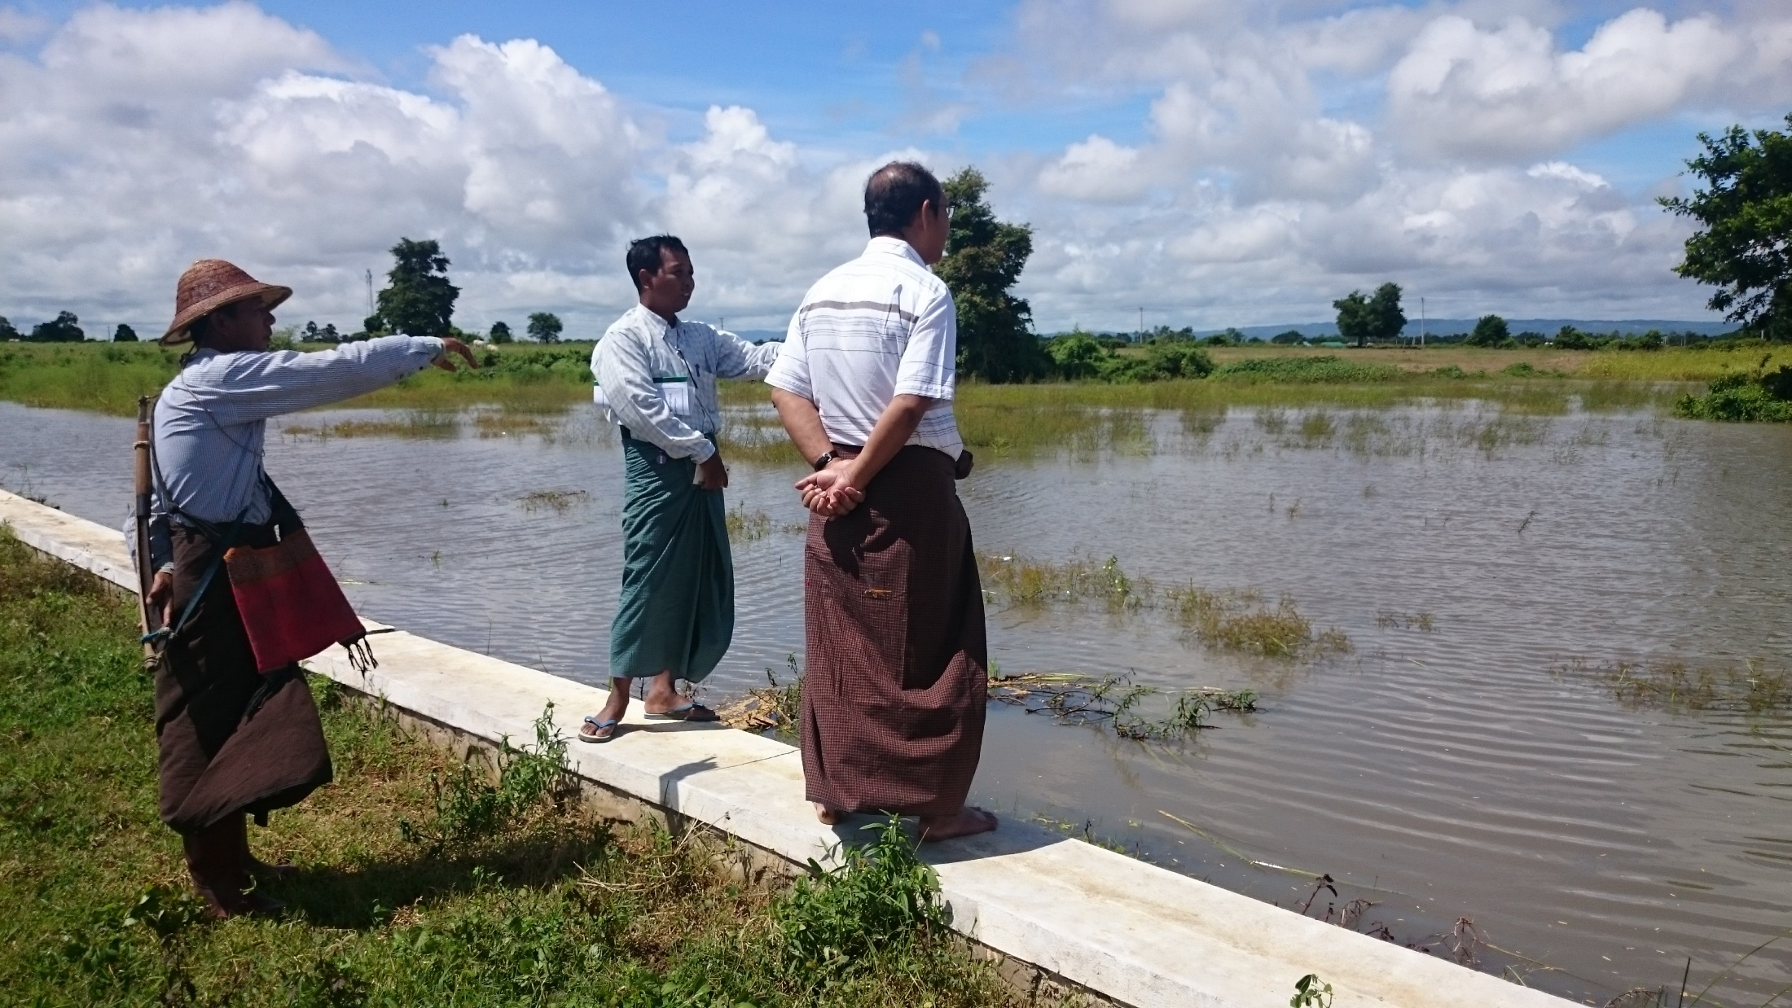
A water pumping system, Tatkone Township

Slide 31
Expected Impact and Outcome
Impact
Improved agricultural land productivity and yield (20% increase) and Income (at least 20% increased) and safely products and to reduce poverty through income generation from GWM demonstration farm

Slide 32
Expected Impact and Outcome
Outcome
Increased 20% in agricultural production
Increased at least 20% in income generation as their alternative livelihoods;
Market access and market demands for the Demo products will increase up to 20%
The target farmer’s income (demonstration and pilot farmers) will increase at least 20%
Support for national policy

Slide 33
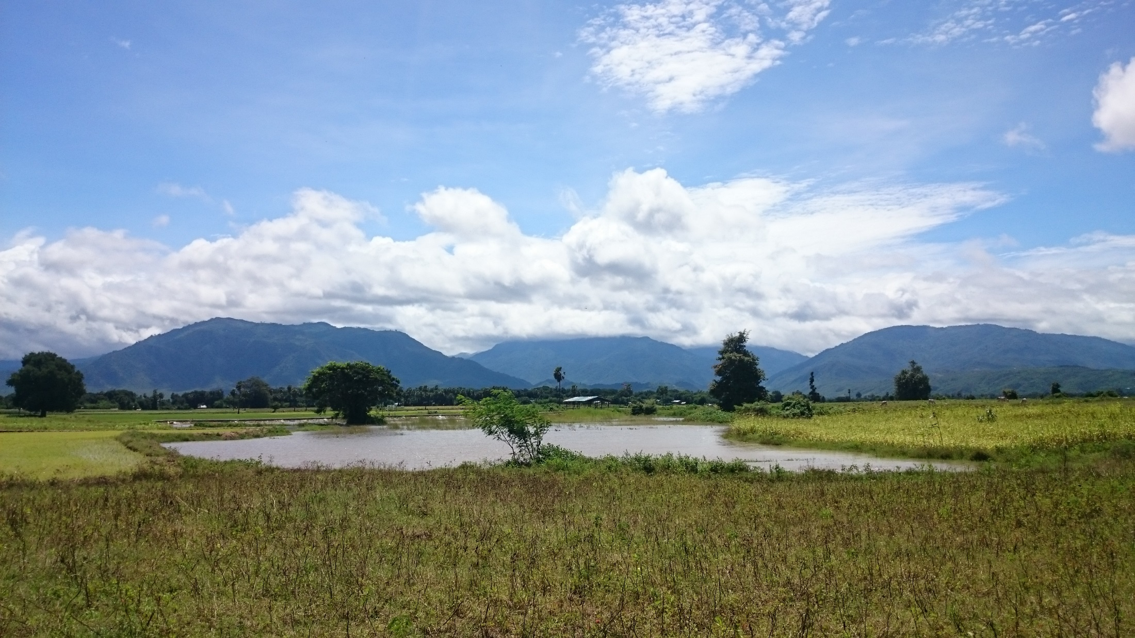
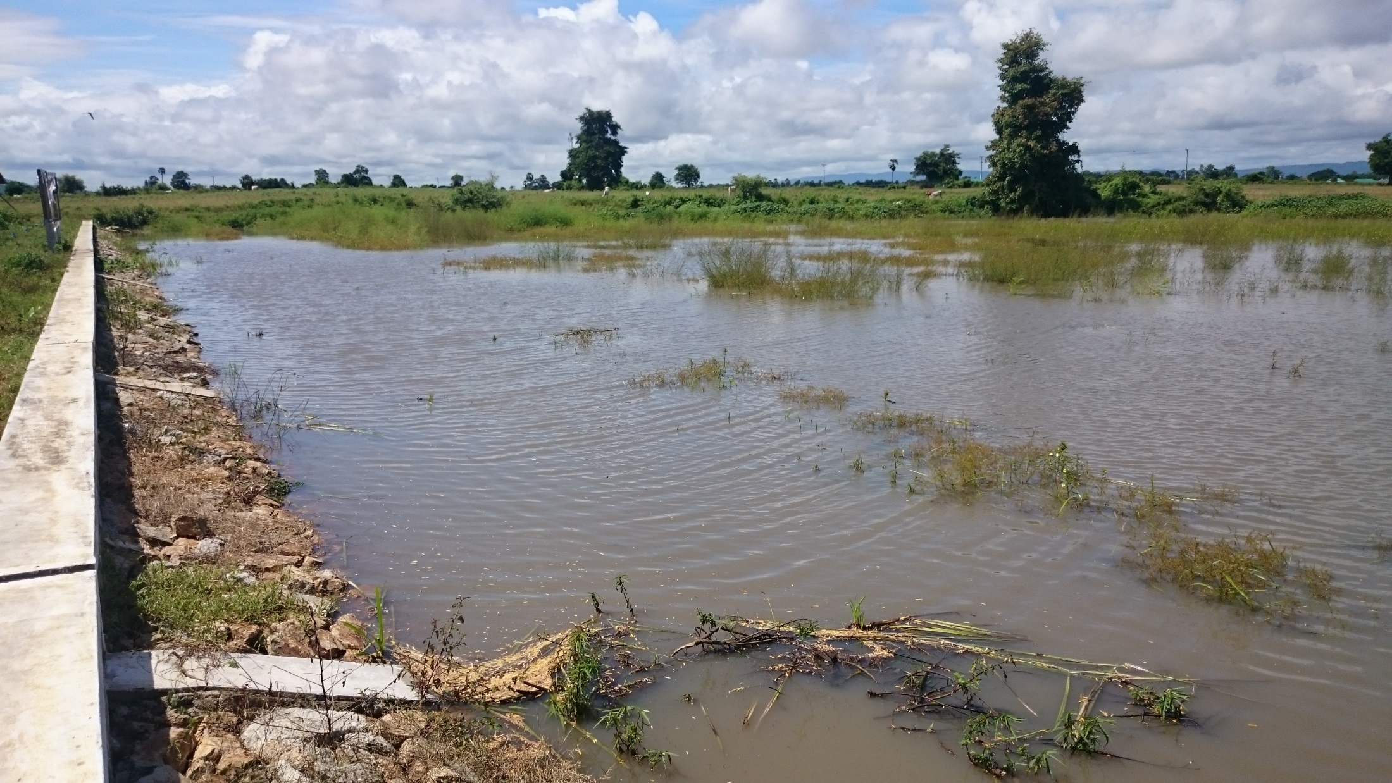
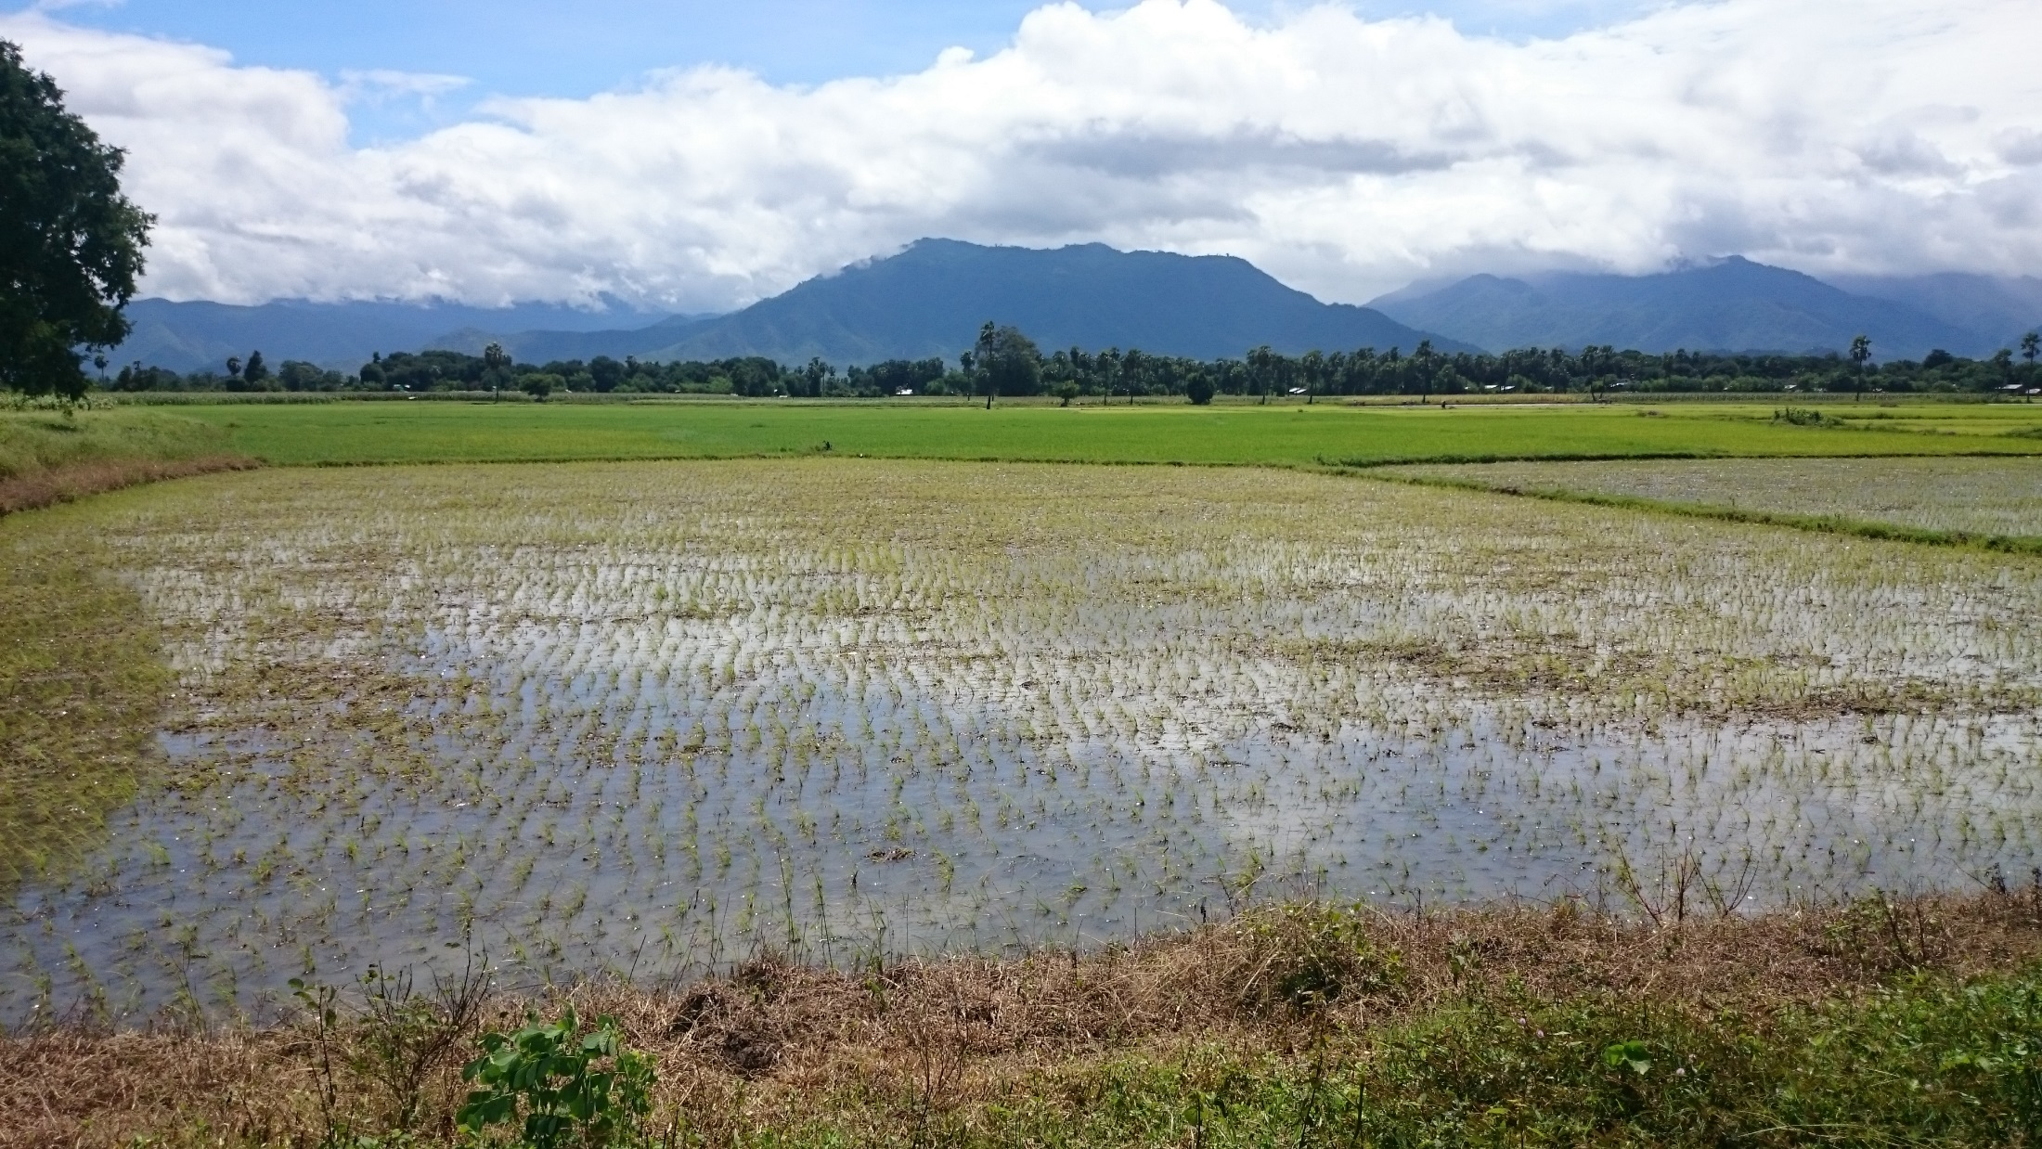
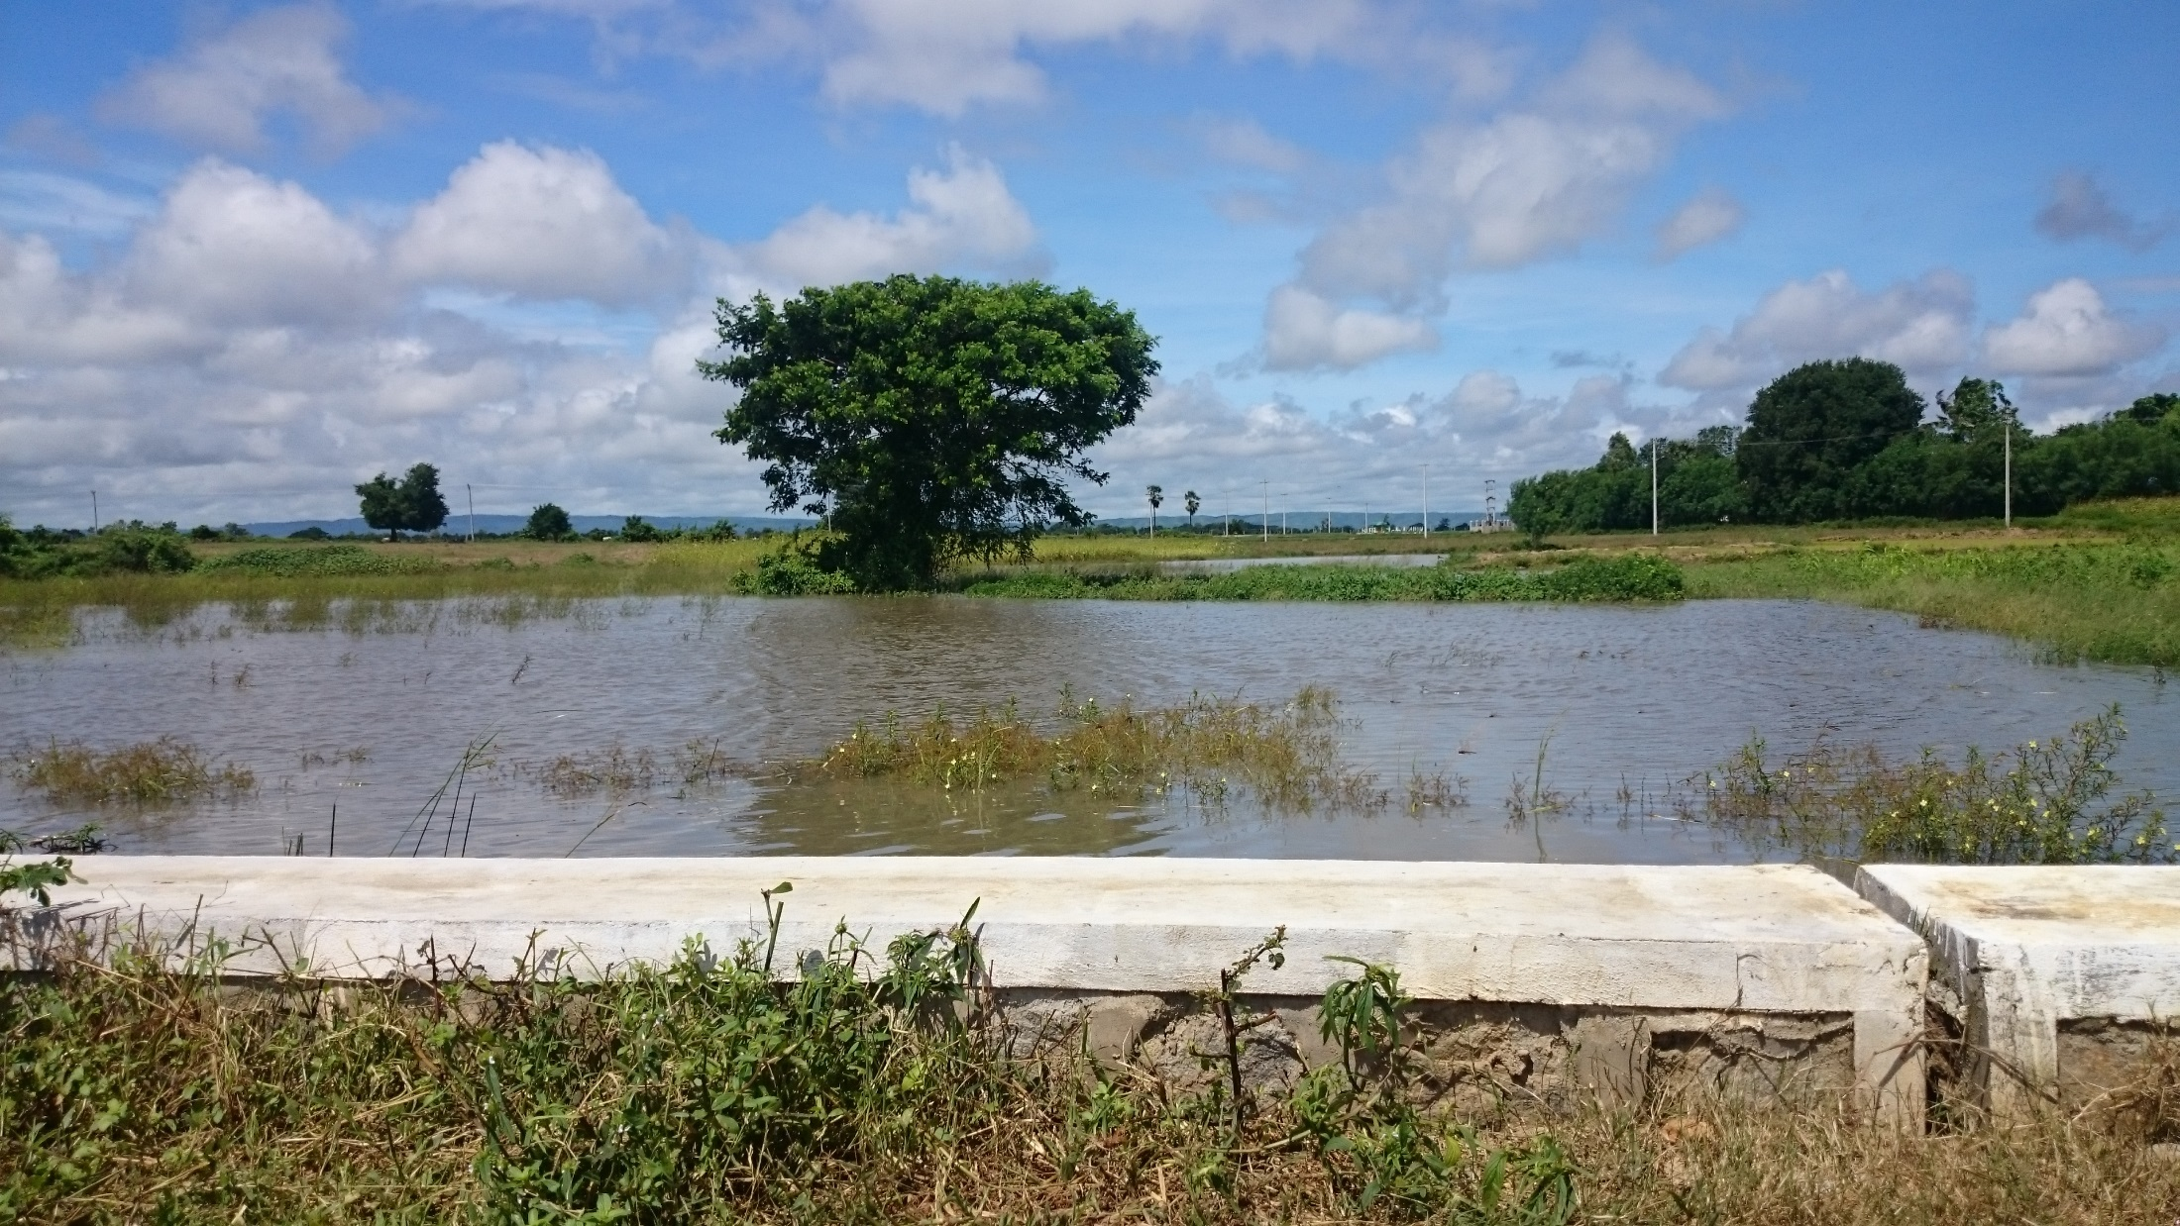
Thank you for your attention

